Slide 1

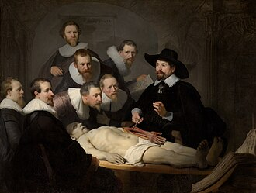
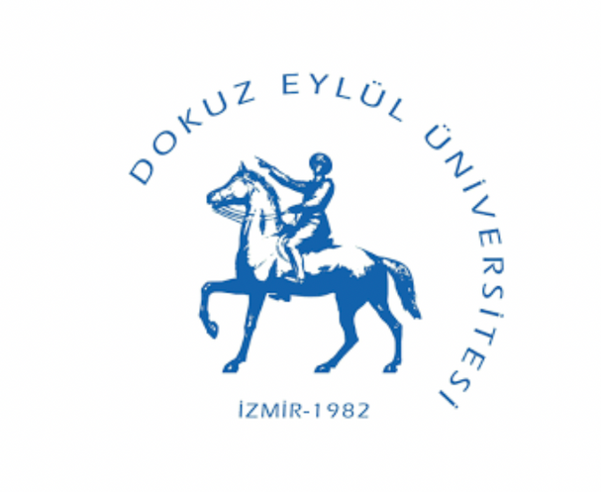



Dokuz Eylul University Institute of Health Sciences
Department of Anatomy
Master's and Doctoral Programs
General Structure and Courses
The Anatomy Lesson of Dr. Nicolaes Tulp, Rembrandt
Dokuz Eylul University Faculty of Medicine Campus, 35340 Balçova/Izmir
0 232 412 43 51

Slide 2
Department of Anatomy
Academic Stuff
Prof. Dr. Çiğdem İÇKE
Prof. Dr. Candan ARMAN
Prof. Dr. Amaç KİRAY
Prof. Dr. Nermin Nüket GÖÇMEN KARABEKİR
Prof. Dr. Funda AKSU
Prof. Dr. Gökşin Nilüfer DEMİRCİ DERİCİ
Assoc. Prof. Dr. Sibel ÇIRPAN
Asst. Prof. Dr. Fatma Gülşah ZEYBEK

Slide 3
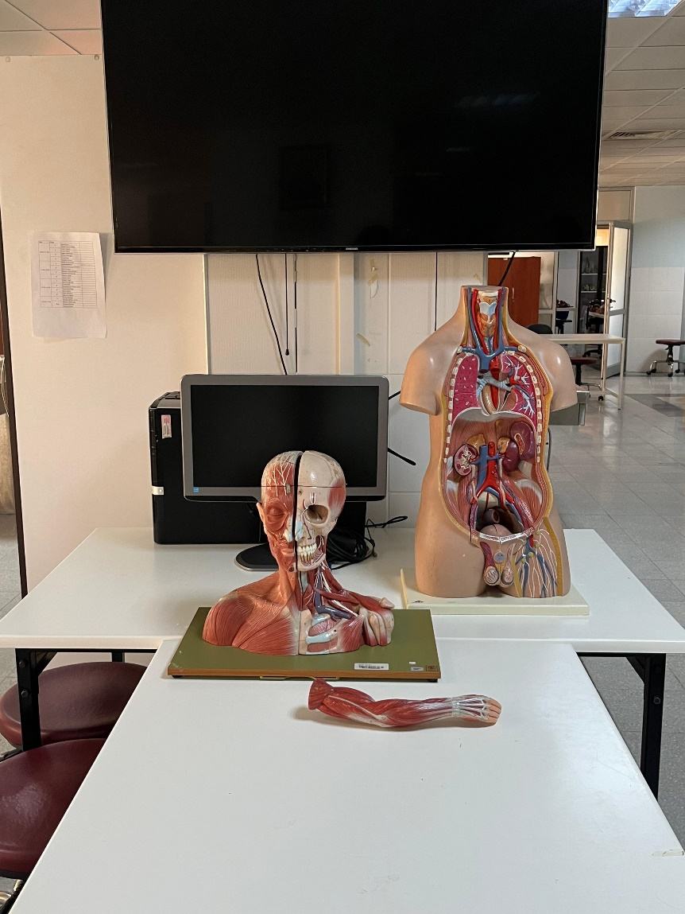
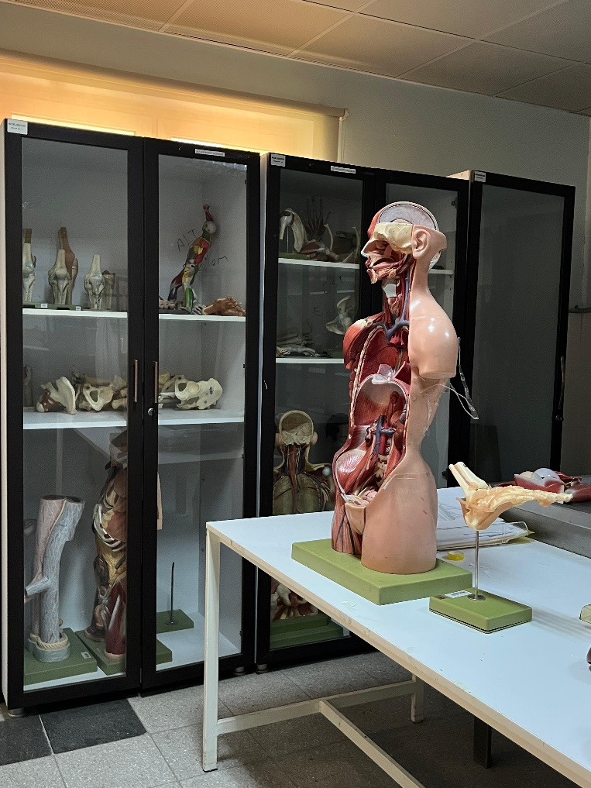
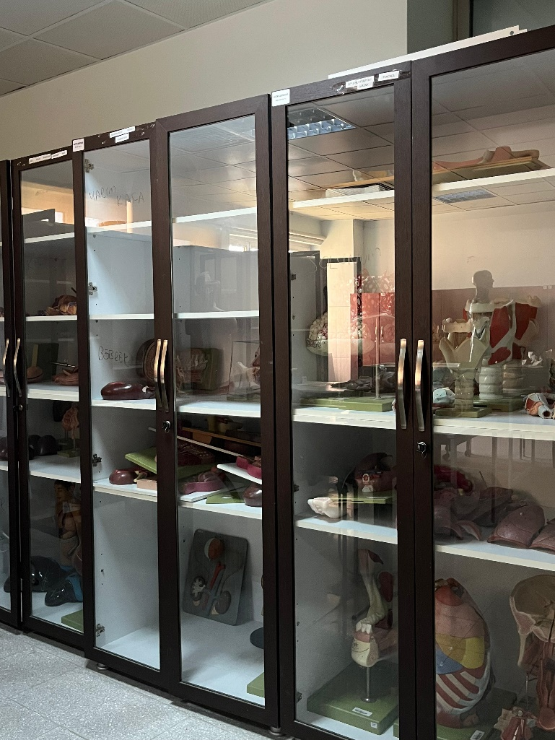
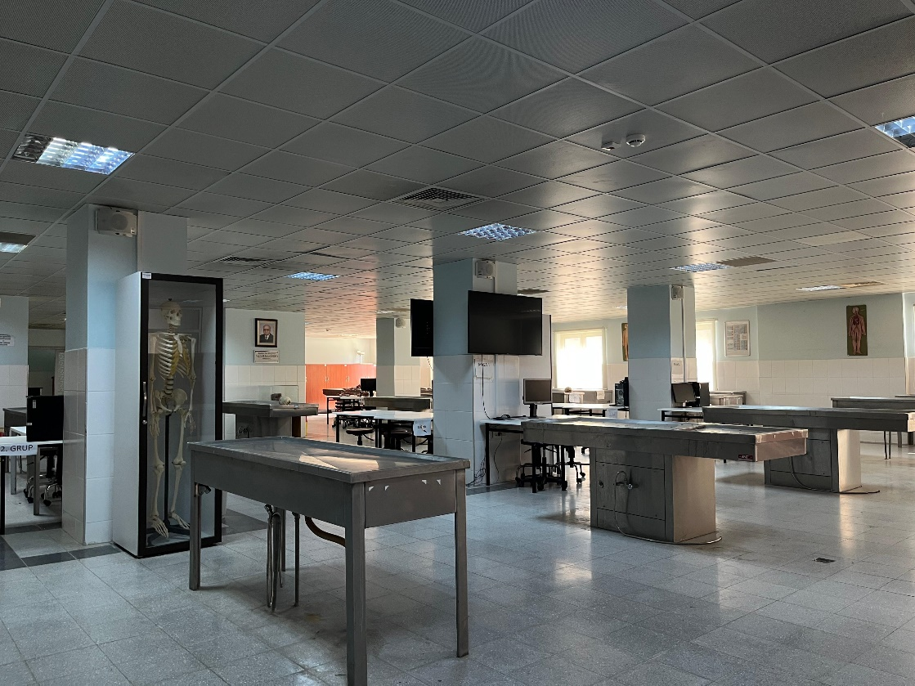
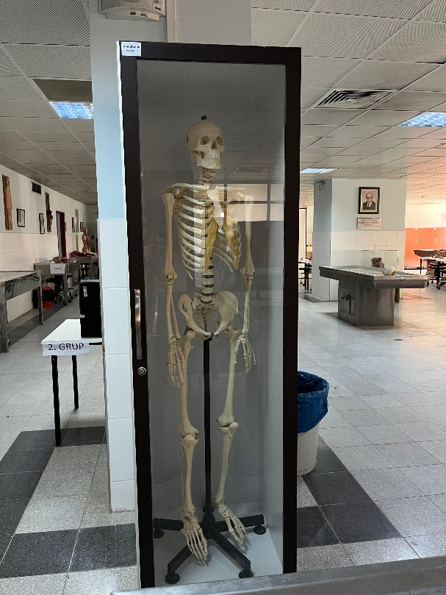
Department of Anatomy
Anatomy Labratory
The Laboratories are equipped with the necessary infrastructure to support advanced anatomical and surgical training through the use of cadaveric materials. Facilities include both formalin-fixed and fresh frozen cadaver preservation systems, along with dedicated spaces for dissection. A high-resolution dissection microscope is available for detailed anatomical studies, and an extensive osteological collection further supports practical training and research.
In collaboration with relevant specialty societies and academic departments within the Surgical and Clinical Sciences — notably Orthopedics and Traumatology, Otorhinolaryngology (ENT), General Surgery, Physical Medicine and Rehabilitation, Plastic Reconstructive and Aesthetic Surgery, and Emergency Medicine — the department organizes hands-on cadaver-based training programs.
These courses are primarily designed for medical specialists and residency trainees, but are also open to other disciplines within the health sciences education domain.

Slide 4
Department of Anatomy
Degree Programs
Master’s Program
Doctorate Program
Aim of Anatomy Masters Degree Program is students specialize in related fields and provides discipline, improve their skills. The main objective of the program, the required contributions to scientific issues related to the human body is capable of efficient and effective work discipline has gained the power to educate people with entrepreneurial skills. Masters Degree program is covered as courses and research the two-year. The first year taking courses related to the field of specialization and thesis preparation period. In addition to the compulsory courses in the curriculum, students specialize on the appropriate area, is an interdisciplinary elective courses. In the second year for the preparation and completion of the thesis is carried out. The program language is Turkish.
Anatomy of PhD students proficiency in relevant areas and disciplines enables developers to build their skills. The main objective of the program, the required contributions to scientific issues related to the human body is capable of efficient and effective work discipline has gained the power to educate people with entrepreneurial skills. Doctoral degree is covered courses and research for four-year program. The first two years taking courses related to the field of specialization and thesis preparation period. In addition to the compulsory courses in the curriculum, students specialize on the appropriate area, is an interdisciplinary elective courses. The program language is Turkish.

Slide 5
Department of Anatomy
Degree Programs Outcomes
1. Has a basic knowledge of general concepts and terminology related to anatomy
2. Has basic knowledge about organs
3. Has a basic knowledge about the locomotor system
4. Has a basic knowledge of central nervous system and sense organs
5. Has a basic understanding of the peripheral nervous system
6. Has a basic knowledge of topographical anatomy
7. Has a basic knowledge of anatomy and dissection methods
8. Has a basic knowledge of occupational skills, and communication related to the field
9. To analyze scientific data related to the field, has the ability to present oral and written
10. Occupational skills related to the field has advanced

Slide 6
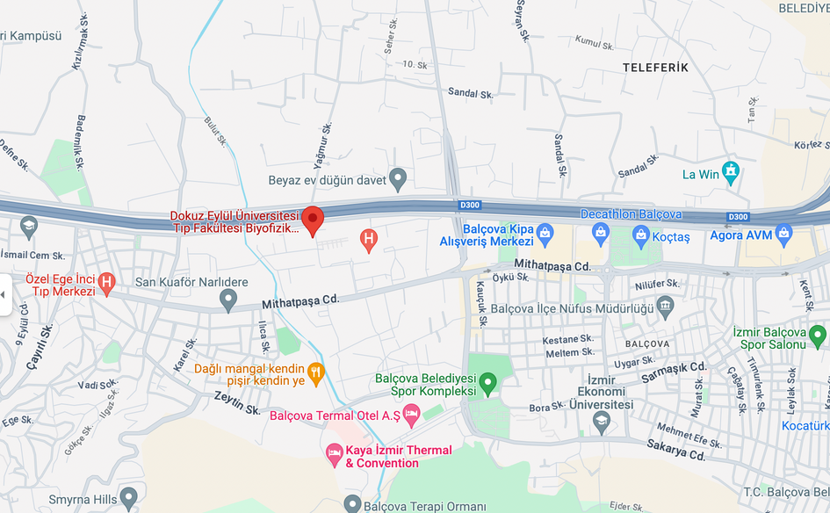

Head of Department of Anatomy
Prof. Dr. Amaç KİRAY
amac.kiray@deu.edu.tr
0232 412 43 60
Dokuz Eylul University Faculty of Medicine Campus, 35340 Balçova/Izmir
0 232 412 43 51

