Slide 1

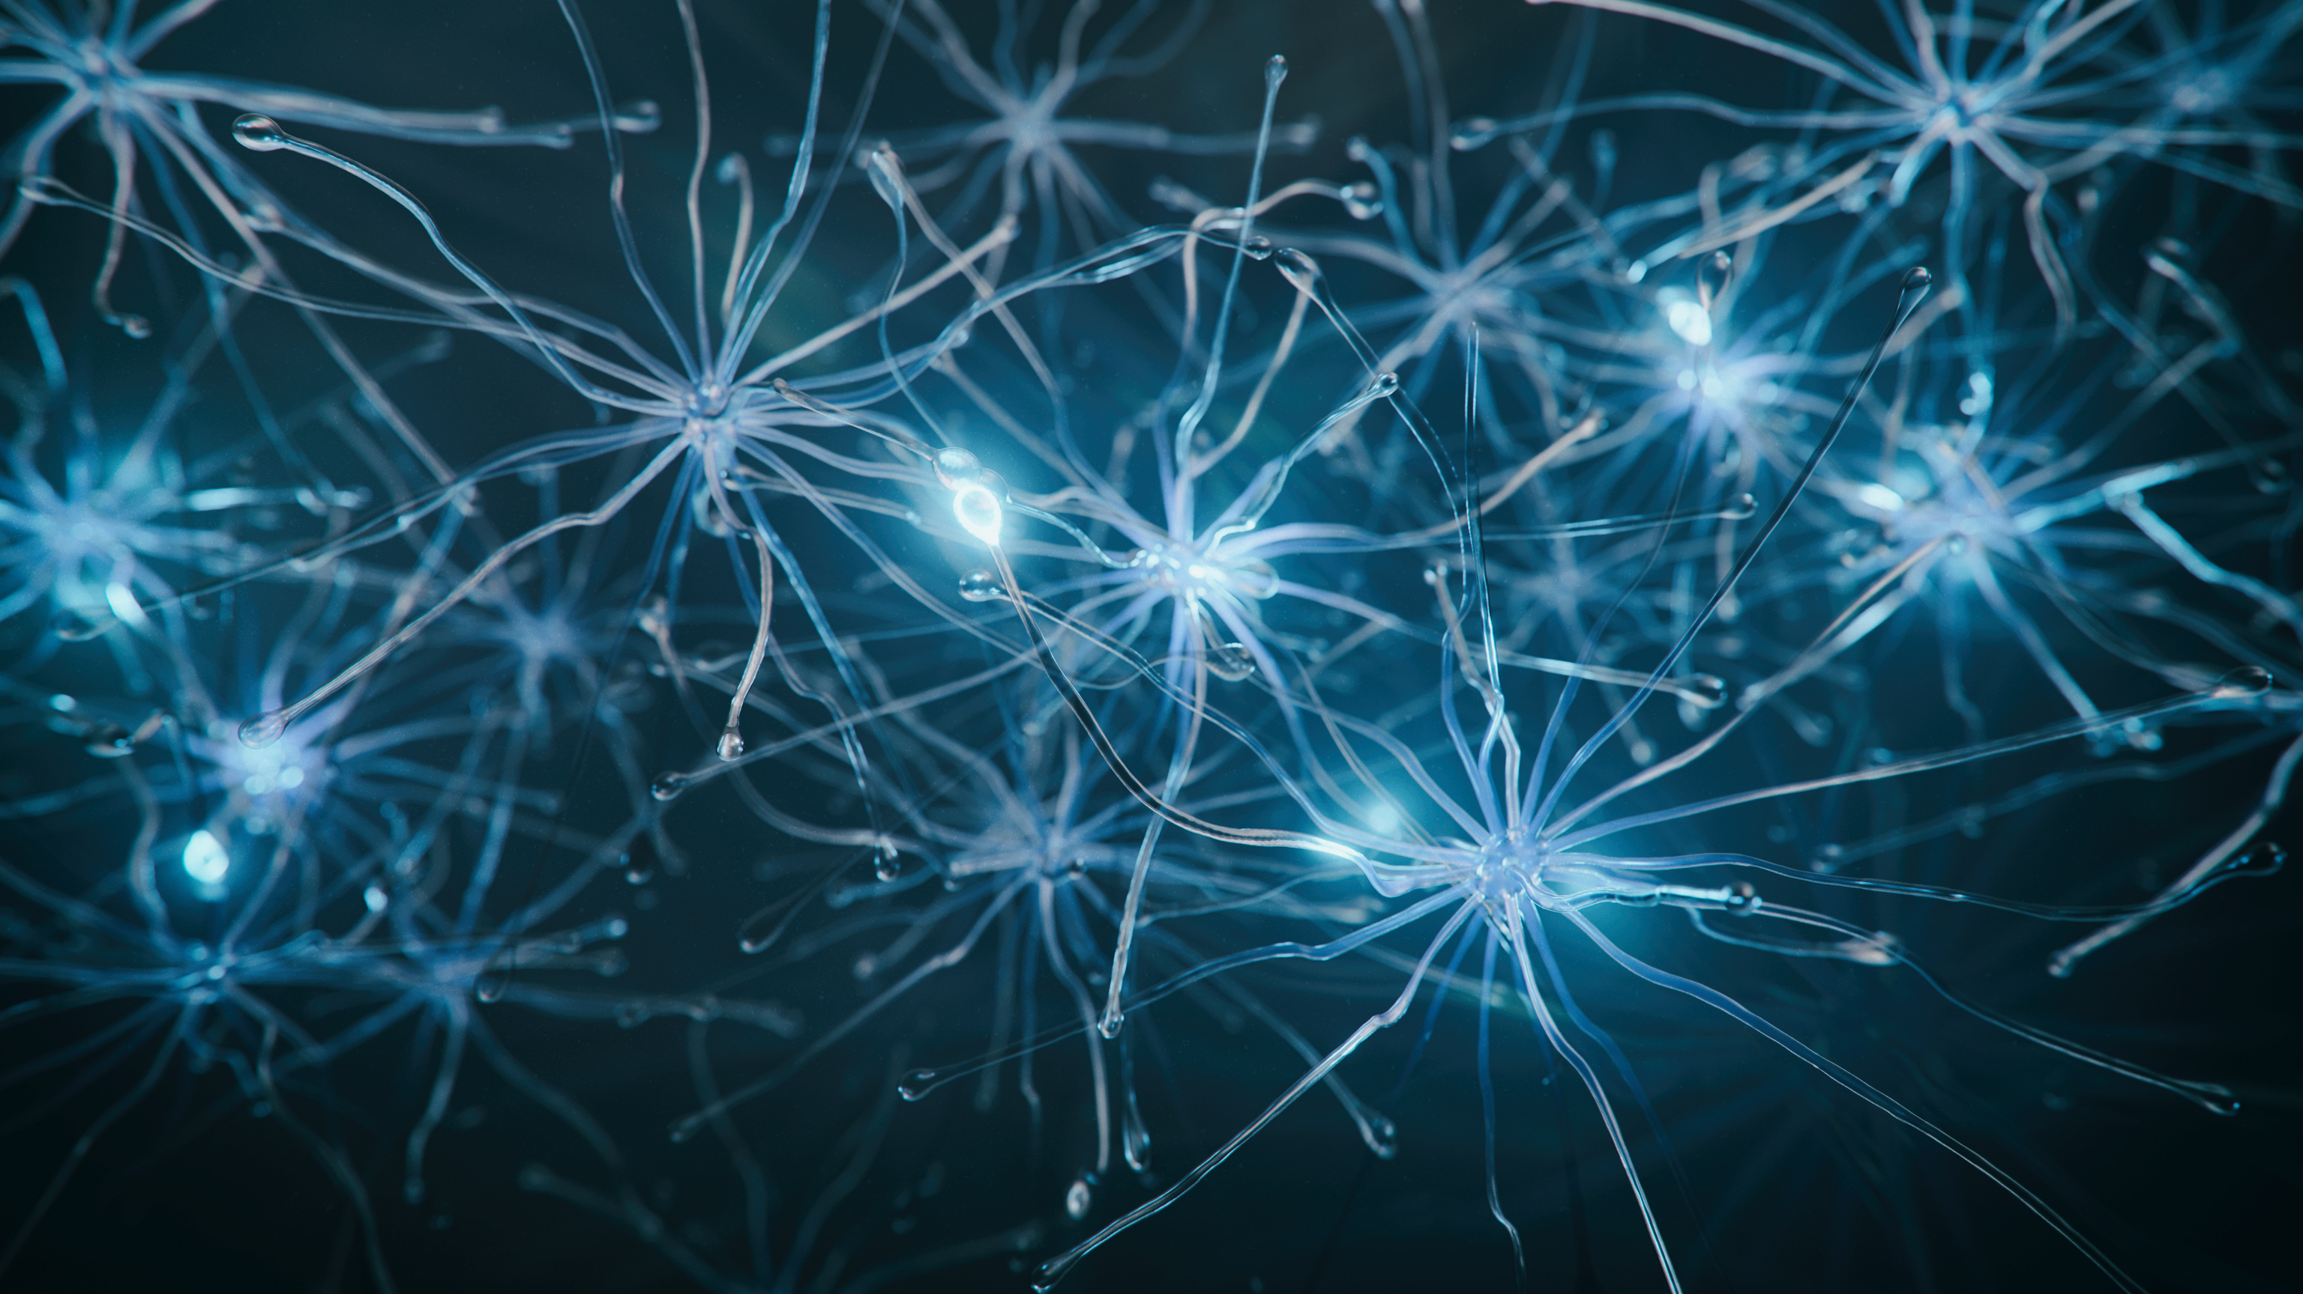



Dokuz Eylul University Institute of Health Sciences
Department of Biophysics
Master's and Doctoral Programs
General Structure and Courses
Dokuz Eylul University Faculty of Medicine Campus, 35340 Balçova/Izmir
0 232 412 44 81

Slide 2

Biophysics Postgraduate
General Structure of Programs
Biophysics is the branch of science in which biological events in living organisms are processed within the scope of the rules of physics and explains the events in cells, tissues, organs, and living systems based on physics. Biology and physics, two basic sciences, intersect today in areas of investigation at both micro- and macro-molecular levels. These intersection areas can be under the umbrella of biophysics and sub-research areas.
Dokuz Eylul University Faculty of Medicine, Department of Biophysics follows a learning and scientific research method known as Brain Biophysics, which brings together various disciplines for the elucidation of brain functions, including neurosciences, clinical branches such as psychiatry and neurology, experimental psychology, and clinical psychology branches, anatomy, radiology, nuclear medicine, engineering, physics, mathematics, linguistics, and statistics in terms of cognitive biophysics and brain dynamics.

Slide 3
Department of Biophysics
Academic Research Areas
Brain asymmetry
(laterality)
Brain oxygenation
Thermal Conductivity
Memory
Learning
Plasticity
Electrophysiological fields of study such as
Event-related potentials and event-related oscillations
Psychiatric and neurological patient groups such as
Schizophrenia, Parkinson's, cerebrovascular diseases, obsessive-compulsive disorder (OCD), attention deficit hyperactivity disorder (ADHD)
Brain under different levels of consciousness
(sleep, wakefulness, anesthesia)
Evoked potentials (visual, auditory, tactile, olfactory, gustatory)

Slide 4
Project Topics
conducted in our laboratory
Dichotic
Coding
Brain Asymmetry
Face
Recognition
Neurophysiological
Imaging
Neurofeedback
Neurophysiological
Testing
Psychovigilance
(PVT)
Brain-body Biophysics
Sport Biophysics

Slide 5
Department of Biophysics
Degree Programs
Master Program
Doctorate Program
Graduates of the program will be able to obtain and process EEG data, apply neuropsychological tests, write reports and make presentations in native and foreign languages, use computers and software. In addition, they have knowledge about the laws of biophysics, cell biophysics, neurological and psychiatric diseases, neurophysiology and neuroanatomy, radiological imaging methods and European Union projects and international projects.
The graduates of the program can obtain and process biological signals such as EEG, ECG, etc., apply neuropsychological tests, conduct projects, write reports and make presentations in native and foreign languages, use computers and software, and transfer the learned biophysical knowledge to students, academicians, and the public.

Slide 6
Department of Biophysics
Master's Program Outcomes
  Mastering the fundamentals of biophysics and basic measurement methods used in biophysics
  Competence to understand the biology of the physiological functions of the brain
  Information about bioelectricity
  To know Bioelectricity and Pathologies
  To have knowledge about article and project writing
  Knowledge of basic signal processing methods and the ability to analyze data at a basic level
  To know Radiation Biophysics and imaging methods
  To have basic knowledge of fluid dynamics
  To have basic theoretical knowledge about neuropsychological test batteries and to be able to apply them
  To know the cell subject
  To know about neurological and psychiatric diseases
  To know statistics for scientific research
  Written and oral expression in mother tongue and foreign language
  Basic computer skills
  Ability to conduct research
  Ability to identify problems and propose solutions
  Having ethical responsibility
  Ability to work as a group, ability to conduct multidisciplinary studies
  EEG and EMG recording skills and EEG recording evaluation skills.

Slide 7
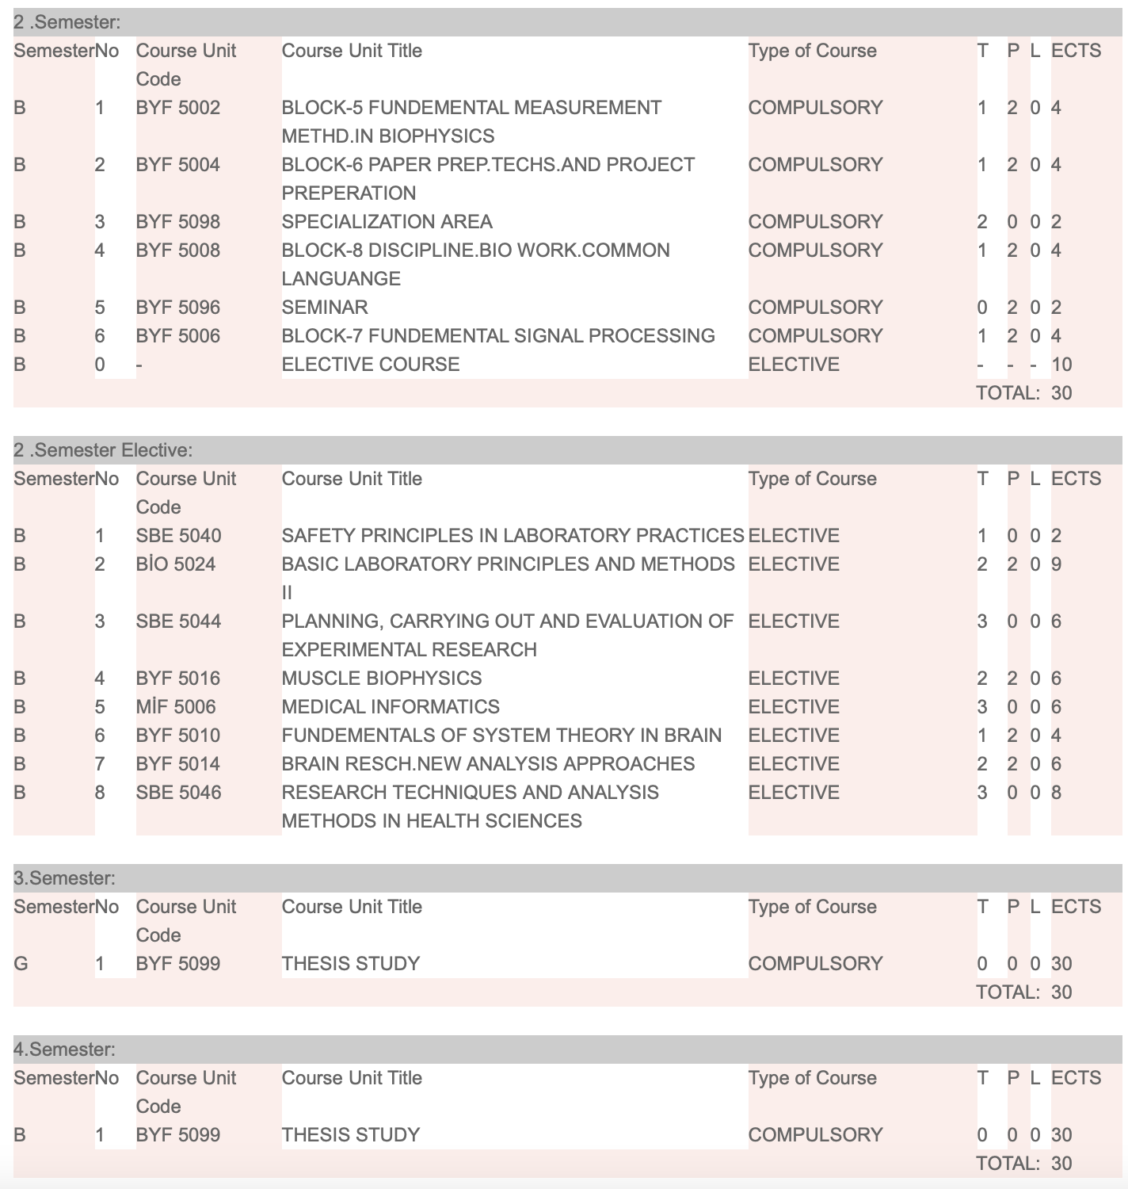
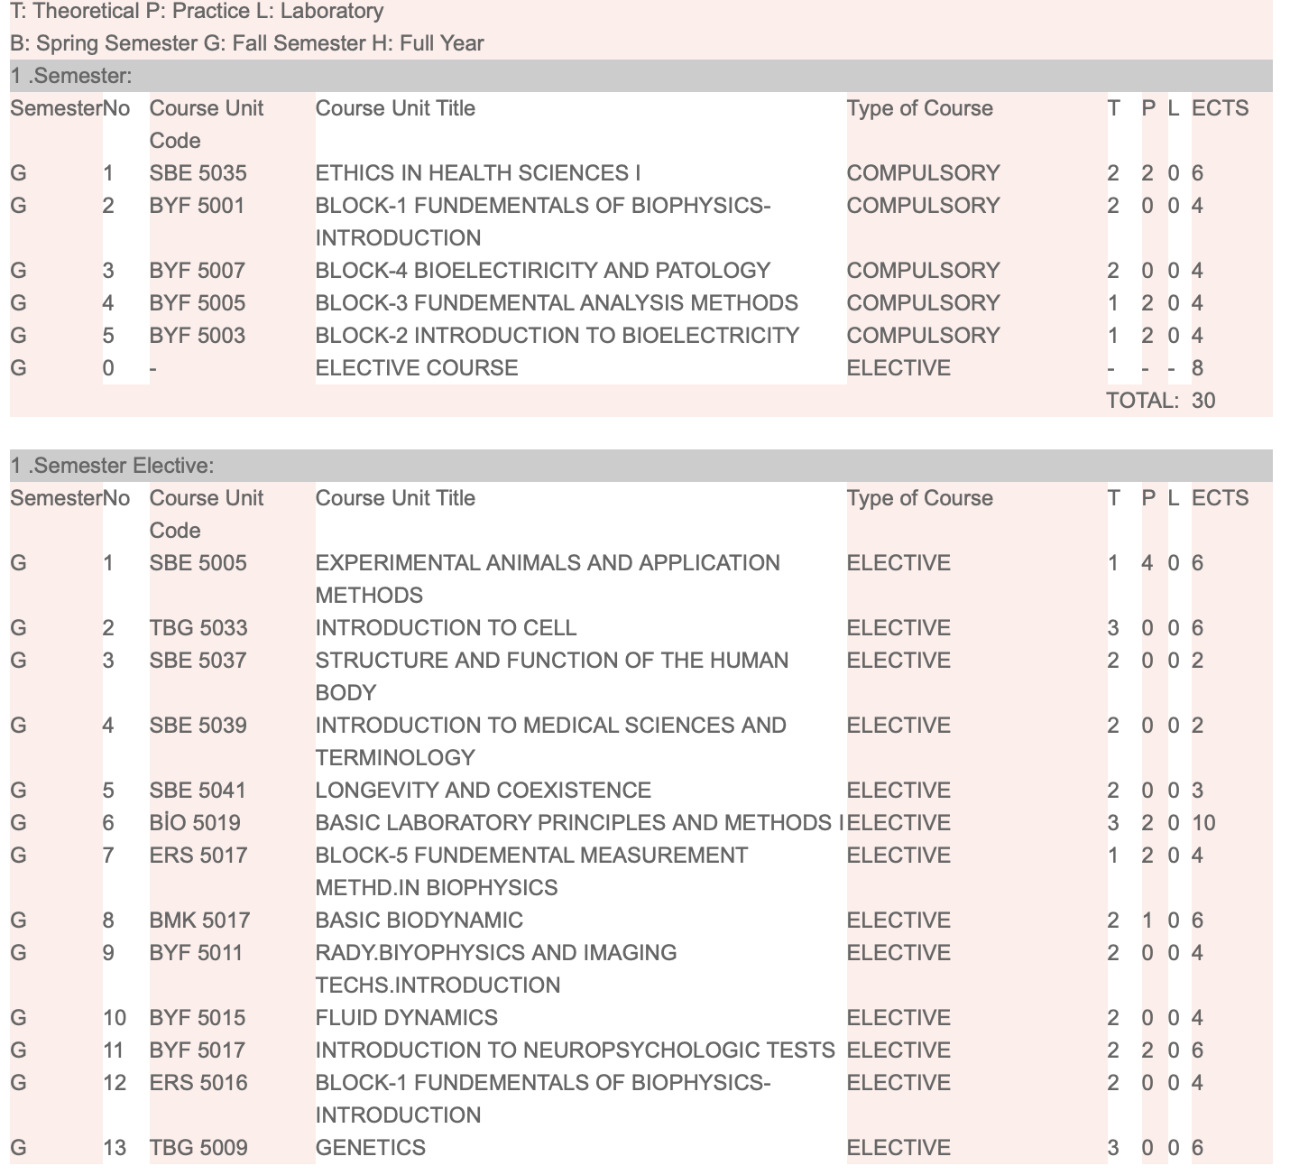
Department of Biophysics
Master Program Courses
In the program, 4 courses in the fall semester and 4 courses in the spring semester are compulsory courses. All other courses are elective. There is no internship requirement.

Slide 8
Department of Biophysics
Doctoral Program Outcomes
  Mastering the fundamentals of biophysics, knowing the basic measurement methods used in biophysics
  Competence in understanding the biology of the physiological functions of the brain, knowledge of brain systems
  To know Bioelectricity and Pathologies
  To know system theory, dynamical systems, and nonlinear systems
  To know article and project writing, to be able to prepare posters, and oral presentations, and to be able to write articles
  Knowledge of basic signal processing methods, knowledge of analysis methods, intermediate-advanced computer skills, and ability to analyze data at an advanced level
  To know Radiation Biophysics and imaging methods
  Mastering fluid dynamics
  To know the theoretical and practical application of neuropsychological test batteries, to be able to apply neuropsychological tests
  To know about neurological and psychiatric diseases
  To know the cell subject
  To know statistics for scientific research
  Written and oral expression in mother tongue and foreign language
  Having ethical responsibility
  Ability to work as a group, ability to do multidisciplinary studies, Group/team working skills (Leadership and team member)
  EEG and EMG recording skills, EEG recording evaluation skills
  Ability to communicate with peers, other academics, and experts, Ability to demonstrate technological, social, or cultural development within the framework of academic and professionalism
  Ability to solve problems, ability to conduct independent research, ability to define and solve problems
  Project management skills, budget management skills, report writing skills
  Ability to supervise the work of others, ability to teach

Slide 9
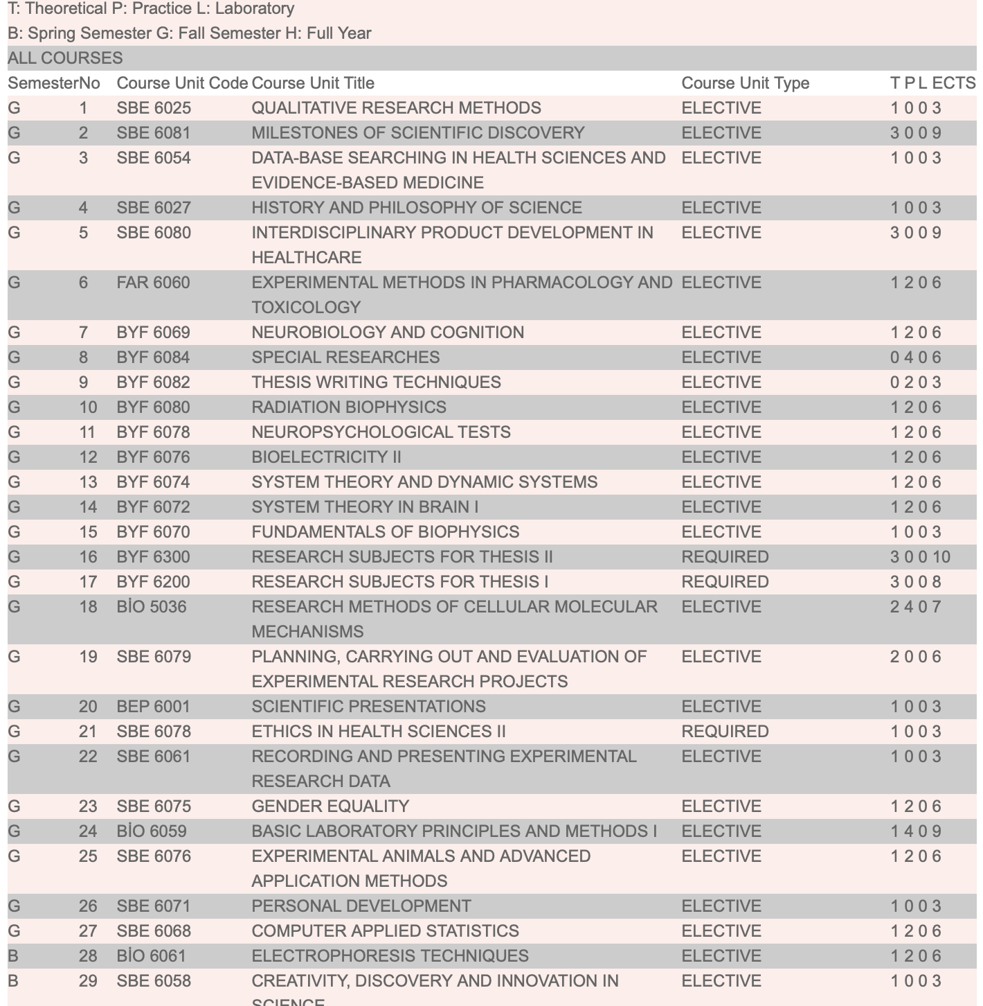
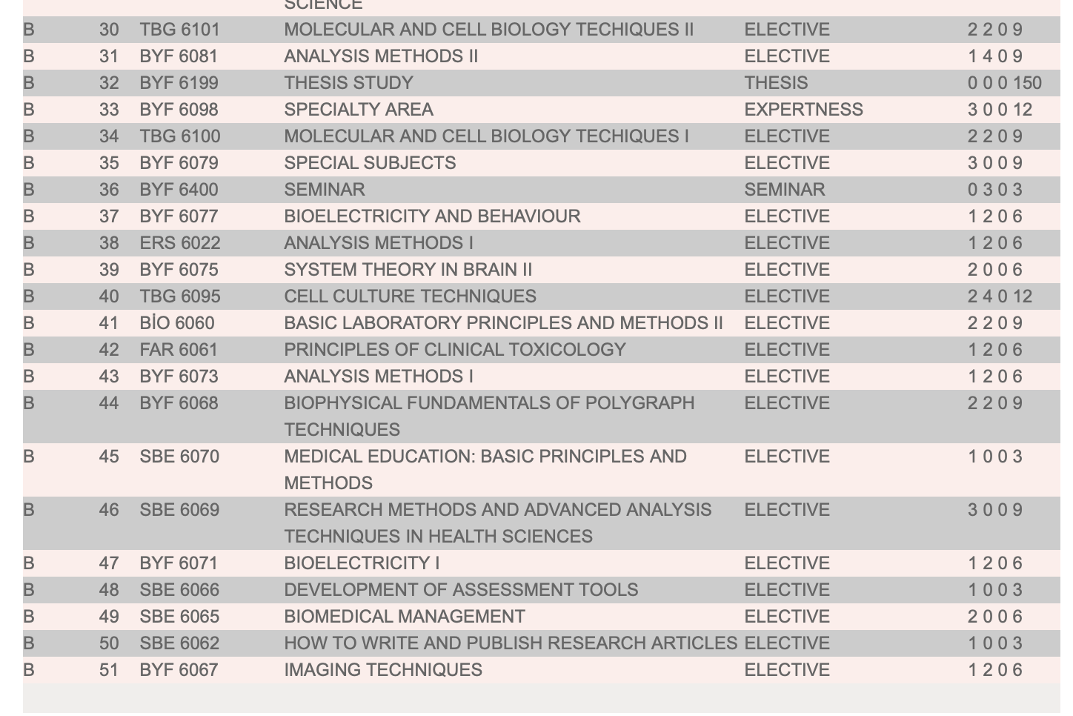
The student must take 30 ECTS each semester. 150 ECTS of the total 240 ECTS must be thesis work. During the Ph.D. education, a total of 90 ECTS (including 12 ECTS Specialization Areas) must be completed from courses in three semesters. During the course-taking period, at least 20 ECTS must be taken from common courses (Research Culture, Research Methods, and Transferable Skills) and at least 20 ECTS from Discipline-Based and Laboratory Skills courses. In addition, students can take 20 ECTS courses from common courses, discipline-based and laboratory skills courses, and/or from other programs or institutions. In the 1st semester, the student must take Research Topics for Thesis I, and in the 2nd semester, the student must take Research Topics for Thesis II as compulsory. Students are required to take an ethics course during the semester.
Department of Biophysics
Doctoral Program Courses

Slide 10

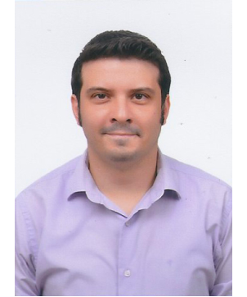
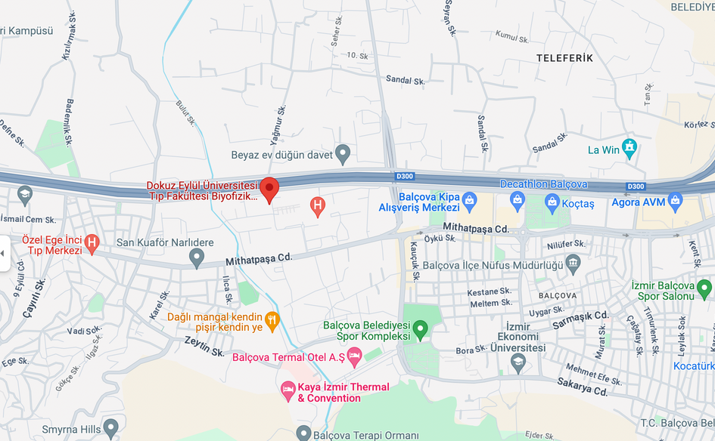

Head of Department of Biophysics
Assoc. Prof. Dr. Çağdaş Güdücü
cagdas.guducu@deu.edu.tr
0232 412 44 81
Faculty Members of the Department
Assoc. Prof. Dr. Serhat Tozburun
Assoc. Prof. Dr. Arif Engin Çetin
Asst. Prof. Dr. Emre Eskicioğlu
Dokuz Eylul University Faculty of Medicine Campus, 35340 Balçova/Izmir
0 232 412 44 81

