Slide 1


Department of Physical Education and Sports
Physical Education and Sport
Doctoral Programme

Slide 2
Physical Education and
Sport Doctoral Programme
The Physical Education and Sports Doctorate Program, which was offered to be opened by our university on 05.10.2018, was examined at the Higher Education Executive Board meeting on 30/10/2018 and the proposal was approved. Physical Education and Sports Doctorate Program was officially opened on 16.11.2018.
The duration of the program is 8 semesters, of which 4 semesters are lectures and 4 semesters are thesis. The language of the program is Turkish.

Slide 3
Specific Admission
Requirements
Second Cycle Degree in the same or in related disciplines. Acceptable score on ALES (Academic Personnel and Graduate Education Entrance Exam) or Equivalent GRE, GMAT score. Acceptable score on Language Proficiency Tests. Acceptable weighted score based on the first or second cycle (with thesis) cumulative grade point average (GPA) and ALES score. International student admission requirements are decided by the Graduate School Executive Committee.

Slide 4
Specific Admission
Requirements
It is required to have an ALES score of 60 from the score type of the program applied for or an equivalent score determined by the Senate from the GRE or GMAT exams.

Slide 5
Specific Admission
Requirements
In application, it is mandatory to get at least 55 points from the central foreign language exams accepted by CoHE or to get a score equivalent to this score from international foreign language exams whose equivalence is accepted.

Slide 6
Qualification Requirements and Regulations
Physical Education and Sport Doctoral Programme
Course Period
Thesis Period
Courses
78 ECTS
Thesis work
150 ECTS
Specialization
12 ECTS
Requirement | Grade
Grade point average for each course | At least 2,50/4,00

Slide 7
Profile of the Programme
Physical Education and Sports Ph.D. program, physical education and sports teaching, coaching, recreation, sports management, sports psycho-social fields in order to make them more scientific and more productive, using knowledge, skills and technology with planning and development features effectively, and able to conduct scientific research and to train academicians and sports scientists who can plan education based on these research findings, follow scientific developments and use them in the professional and academic field. In addition to postgraduate education, Doctoral Education complements advanced knowledge and techniques, research methods and skills in this field.

Slide 8
Profile of the Programme
As a result, our aim is to attract people to sports, to raise awareness of the public and to create a sports culture in the society in our region, where we want sports to become widespread and to be carried out on more scientific grounds, and to train experienced sportsmen in practical studies and laboratory research in the fields of physical education and sports teaching, coaching, recreation, sports management, sports psycho-social, etc.

Slide 9
Student Details
Year | Actively Studying Students | Graduated Students
2019 | 3 | -
2020 | 7 | -
2021 | 8 | -
2022 | 10 | -
2023 | 9 | -
2024 | 9 | 4
2025 | 5 | 1

Slide 10
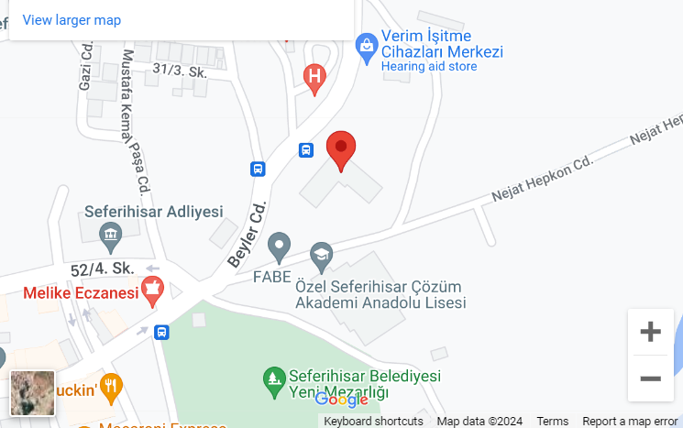
Contact Information
Address: Turabiye Mah. Beyler Cad. No:4 Seferihisar/İzmir
Phone number: +90 232 743 51 10

