Slide 1
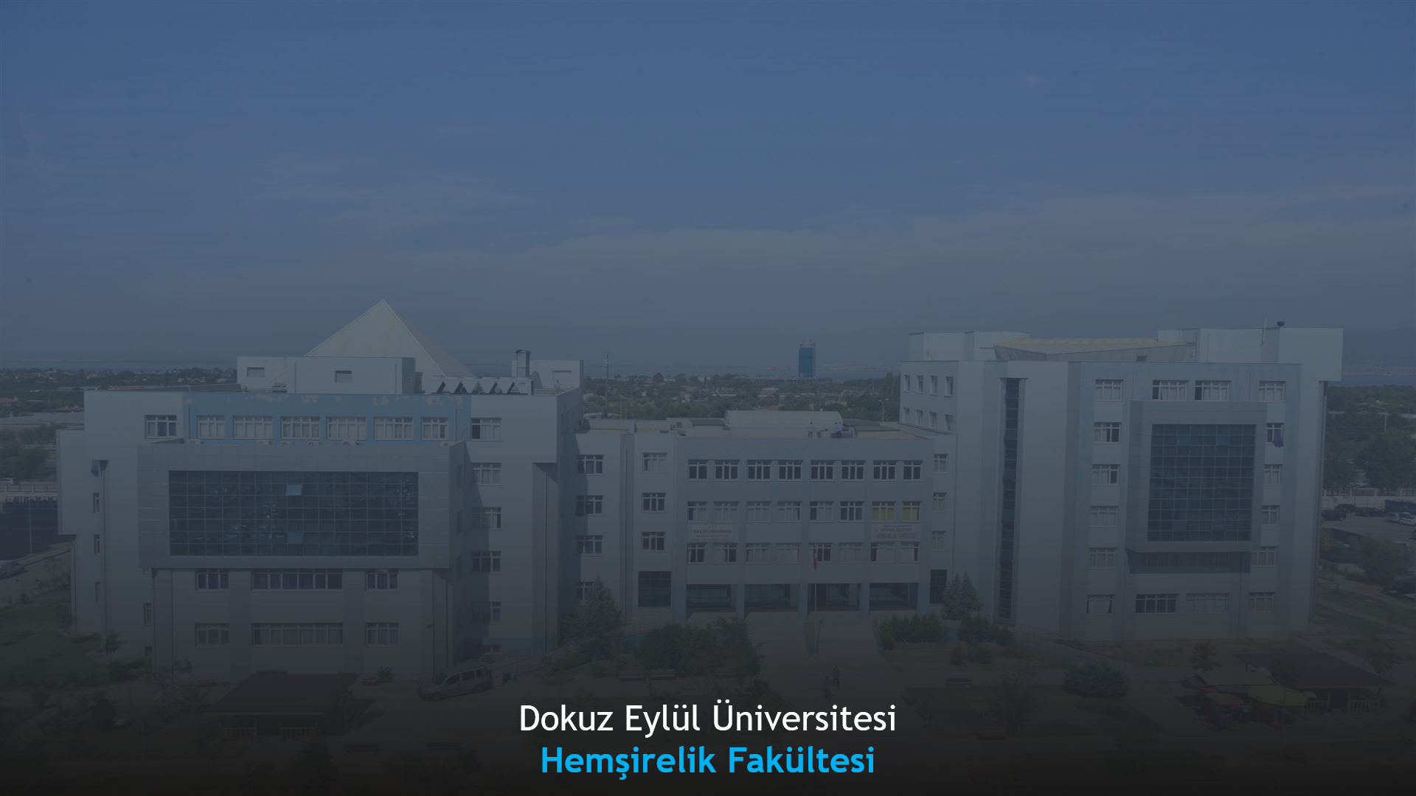
Republic of Türkiye
DOKUZ EYLÜL UNIVERSITY
The Institute Of Health Sciences
Department Of Nursing
Second Cycle Programmes (Master's Degree)
Third Cycle Programmes (Doctorate Degree)
Introductory Presentation

Slide 2

Msc Programmes
Fundamentals of Nursing
Internal Medicine Nursing
Surgical Nursing
Pediatric Nursing
Obstetric and Gynecologic Nursing
Community Health Nursing
Nursing Management
Psychiatric Nursing
Oncogology Nursing
PhD Programmes
Fundamentals of Nursing
Internal Medicine Nursing
Surgical Nursing
Pediatric Nursing
Obstetric and Gynecologic Nursing
Community Health Nursing
Nursing Management
Psychiatric Nursing
Oncogology Nursing
2

Slide 3
FUNDAMENTALS OF NURSİNG MASTER'S DEGREE AND PhD PROGRAM
Number of students graduating from the master's degree program until 2023: 16
Purpose of the program: The objectives of this programme are obtaining knowledge about the four fundamental concepts of nursing, which are human, health, environment and nursing, and acquires the knowledge and skill of providing care based on psychomotor skill development theory and models, ethical principles, and the necessary knowledge, skill and attitude in order to determine, plan and practice nursing care necessities by using DLAM in case of health problems of individual/family and society, improving presentation skills, developing ability to follow, interpret and present domain-specific scientific research, acquiring knowledge and skills on basic research methods in Fundamentals of Nursing.
Number of students graduating from the PhD program until 2023: 5
Purpose of the program: The oblectives of this programme are contribute of improving to Fundamentals of nursing by doing original researches for developing new idea, methods and practices; to follow and use evidence based practices; and to decide according to take into consideration of patients preferences.
Fields of Study: Studies on internal medicine, surgery, intensive care units, Intensive Care Nursing, Palliative care nursing, Nursing education, Psychomotor skill teaching, Simulation, Student Training in Simulation, Nursing concept, Nursing theories and models, Care protocols, Patient safety, nursing care sensitive patient outcomes, Evidence-based practices, Nursing ethics, Professionalism in nursing, Systematic approach in nursing, IM-IV-SC Treatment Nursing and care, Individual-Centered Care, Symptom Management, Pain Management, Clinical practices, complementary therapies, oral care, Skin-Wound care, Respiratory system applications and care, Aspiration applications, tracheostomy patient care, Urinary system applications and care, GIS applications and care, Stoma application and care.
3

Slide 4
INTERNAL MEDİCİNE NURSİNG MASTER'S DEGREE AND PhD PROGRAM
Number of students who graduated from the master's program by 2023: 47
Internal Medicine Nursing Master's Program: The aim of the program is to provide contemporary knowledge to perform the roles and responsibilities of Internal Medicine Nursing and to ensure that this knowledge and skills are used in the care management of individuals with chronic diseases. Our aim is to advance the undergraduate career in nursing to the next level, to understand the field more deeply and to train expert nurses who can offer solutions to the problems in the field.
Number of students who graduated from the PhD program by 2023: 12
Internal Medicine Nursing Doctorate Program: The aim of the program is to provide in-depth knowledge and skills about the basic concepts and theories of Internal Medicine Nursing. To train nurses, researchers and academicians in advanced practice roles who can bring new solutions through research to problems affecting individuals, communities and health systems, and create new ideas, new methods and programs.
Fields of Study: Cardiology Nursing, Diabetes Nursing, Geriatric Nursing, Internal Medicine Working Areas, Intensive Care Nursing, Rehabilitation Nursing, Home Care Nursing, Palliative Care Nursing, Educational Nursing, Nursing Education, Evidence-based practices, Research, Experimental Research, Qualitative Research, Technology, Home Care, Aging, Empowerment, Self-care, Self-management.
4

Slide 5
SURGICAL DISEASES NURSING MASTER'S DEGREE AND PhD PROGRAM
Number of students graduating from the master's degree program until 2023: 61
Purpose of the programme: The purpose of this programme is; to provide contemporary and evidence-based information that can meet the roles and responsibilities of surgical nurses, to use this knowledge and skills in surgical patient care management, to conduct research on the pre-intra-and post-operative care of surgical patients, and to follow scientific developments and innovations in the field.
Number of students graduating from the PhD program until 2023: 18
Purpose of the programme: The purpose of this program is to ensure that the student is ready for field courses and practices by ensuring that the student focuses on developing and changing new knowledge on the basic concepts of surgical nursing, adult development periods, pre-, intra- and post-operative nursing, perioperative education of the individual and the family, and to contribute to the thesis subject in line with the theory-based model.
Fields of Study: Studies on patients receiving treatment and care in all surgical fields (Operating Room, Anesthesia and Reanimation, Anesthesia and Reanimation Intensive Care, Emergency Service, Pediatric Surgery, General Surgery, Thoracic Surgery, Ophthalmology Surgery, Day Surgery, Cardiovascular Surgery, Thoracic-Cardiovascular Surgery Intensive Care, Ear Nose and Throat Surgery, Neurosurgery, Orthopedics and Traumatology, Plastic and Reconstructive Surgery, Sterilization Unit, Urology), Emergency Nursing, Operating Room Nursing, Wound and Stoma Nursing, Intensive Care Nursing, Transplantation Nursing, Management of Surgical Pain, Symptom Management in the Surgical Patient, Ethical and Legal Issues in the Management of the Surgical Patient, Treatment and Care of the Burn Patient, Evidence-Based Practices, Basic Concepts in Surgical Nursing, Use of Theories and Models in Surgical Nursing, Innovations in Surgical Nursing, Care Packages, Standards and Care Protocols for the Management of the Surgical Patient, Patient and Employee Safety, Nursing Education, Applications in Surgical Clinics.
5

Slide 6
PEDIATRIC NURSING MASTER'S DEGREE AND PhD PROGRAM
Number of students graduating from the master's program by 2023: 39
The porpuse of the program is to provide students with contemporary knowledge that can meet the roles and responsibilities of Child Health and Disease nurses, and to ensure that this knowledge and skills are used in patient care management.
Number of students graduating from the PhD program until 2023: 12
The porpuse of the program is to: Conduct original research to contribute to the improvement of Child Health and Disease Nursing, develop new ideas, methods and practices, and base nursing practices on evidence-based studies.
Fields of Study: Social pediatrics, promotion and protection of child health, school nursing, children with special needs, Child Health Services, pediatric surgery, studies in neonatal and pediatric intensive care units, Pediatric Palliative care nursing, Pediatric Nursing education, Psychomotor skill teaching, Simulation, Nursing concept, Nursing theories and models, Care protocols, Patient safety, Evidence-based practices, Nursing ethics, Professionalism in nursing, Systematic approach in nursing, Family Centered Care, Symptom Management, Pain Management, Clinical applications, complementary therapies, Artificial nutrition, Virtual reality
6

Slide 7
OBSTETRİCS AND GYNAECOLOGY NURSİNG MASTER'S DEGREE AND PhD PROGRAM
Number of students graduating from the master's degree program until 2023: 46
Purpose of the program: To understand the roles and responsibilities of women's health nursing in the world and Turkey, to understand women's health problems, develop a nursing perspective on problems and produce solutions, observe different application areas related to women's health, develop field-specific clinical experience, fill a scientific gap in the field and conduct specialization theses in current area.
Number of students graduating from the PhD program until 2023: 15
Purpose of the program: To approach women's health with holistic care, to follow, analyze, synthesize and evaluate innovations in the field, to solve problems by producing new knowledge by using theories and models, also to apply and teach knowledge.
Fields of study: Gynecology and Obstetrics Clinics, Birth Room, Risky Pregnancies, Infertility Centers, Community Health Centers, Birth Preparation Classes, Postpartum Classes, Urogynecology area, Breastfeeding Consultancy, Women's Health Fields in Different Life Periods, Nursing Education, Nursing Theory and Models , Care protocols, Evidence-based practices, Professionalism in nursing
7

Slide 8
COMMUNITY HEALTH NURSİNG MASTER'S DEGREE AND PhD PROGRAM
Number of students graduating from the master's degree program until 2023: 32
Purpose of the program: Number of students graduating from the master's program by 2023: 16The aim of the program: Having professional nursing awareness, being sensitive to the health problems and care needs of the individual, family and society at national and international levels, applying the basic principles of public health nursing based on the individual, family, and society, being aware of the health needs of the society and giving priority to important health problems. and to train Public Health Nursing specialists who have the qualifications of universal scientists in Public Health Nursing education and research, who have sufficient knowledge and skills in planning education, ensuring community participation, developing evidence-based practices and being an advocate for society.
Number of students graduating from the PhD program until 2023: 14
Purpose of the program: The aim of the program: Having the qualifications of a universal scientist in education and research in the field of Public Health Nursing, being sensitive to the health problems and care needs of the individual, family and society at the national and international level, using community-supported, multidisciplinary approach methods for protecting and improving health and solving health problems in the field of nursing. To train doctors of science in Public Health Nursing who can use their knowledge, develop programs in the fields of public health nursing, and plan and carry out research.
Fields of Study: Studies on Primary Health Services, Family Health Center, Cancer Early Diagnosis and Treatment Center, School Health, Occupational Health, Maternal and Child Health, Home Care, Community Mental Health, Tuberculosis Dispensary, Prison, Immigrant Health units, Evidence-based practices, Nursing ethics , Professionalism in nursing, Elderly care, Pregnant and postpartum follow-up, Vulnerable groups, Health Protection and Promotion, Teaching Healthy Lifestyle Behaviors, Vaccinations, Health Education, Management of Chronic and Infectious Diseases
8

Slide 9
NURSİNG MANAGEMENT MASTER'S DEGREE AND PhD PROGRAM
Number of students graduating from the master's degree program until 2023: 48
Purpose of the program: The aim is for the student to access current knowledge in the field of nursing management, to critically evaluate the knowledge and then transfer it to the field of practice to improve managerial skills and competencies, and to learn scientific research processes related to nursing management.
Number of students graduating from the PhD program until 2023: 11
Purpose of the program: It is aimed to have an innovative approach by examining issues related to the field of nursing management from a broad and deep perspective in order to gain independent researcher qualifications, and to be able to use the basic theoretical knowledge in the field to solve problems in the field of nursing management.
Fields of Study: Leadership and empowerment, teamwork and patient outcomes, nurse turnover, the impact of the work environment on nurse and patient outcomes, patient safety, quality management, creating a healthy work environment.
9

Slide 10
PSYCHİATRİC NURSİNG MASTER'S DEGREE AND PhD PROGRAME
Number of students graduating from the master's degree program until 2023: 39
Purpose of the program: The aim of the Psychiatric Nursing Master's program is to be able to handle individuals with their bio-psychosocial dimensions, to combine the knowledge of concepts and models for protecting and improving mental health with practice, to be able to develop and protect mental health and to undertake the responsibility of caring for individuals with mental disorders and their families, to be sensitive to ethical principles. To train psychiatric nurses who are aware of their responsibilities and have advanced problem solving, critical thinking and research skills.
Number of students graduating from the PhD program until 2023: 11
Purpose of the program: The aim of the Psychiatric Nursing Doctorate program is to examine psychiatric nursing services in psychiatric clinics and in the field, to be able to critically approach the position of psychiatric nursing, to identify problems and produce projects, to learn to use research data and models regarding the care results related to the provision of psychiatric services, to create new models and to critically evaluate them. It aims to examine its contribution to nursing knowledge.
Fields of Study: Strengthening individuals with severe mental illnesses and their families, working with patients' relatives and related groups in combating stigma against mental illnesses, risk diagnosis and management of acute conditions in psychiatry services, protecting and improving the physical health of individuals with severe mental illnesses, helping individuals diagnosed with cancer. and strengthening their families, psychological empowerment of nurses, strengthening communication skills in nursing, improvement in individuals diagnosed with depression.
10

Slide 11
ONCOGOLOGY NURSİNG MASTER'S DEGREE AND PhD PROGRAM
Number of graduating students from the master's program until 2023: 12
Purpose of the program: The purpose of this program is to equip students with in-depth knowledge about the mechanisms, etiology, prevalence of cancer both in our country and globally, methods of cancer prevention and early diagnosis, mechanisms, symptoms, signs, and treatments of the most prevalent cancers in our country, the dying process, communication with cancer patients and their families, understanding psychosocial issues faced by cancer patients and their families, ability to plan nursing interventions, keeping up with scientific advancements in the field, and possessing research knowledge and skills in the field.
Number of graduating students from the doctoral program until 2023: 0
Number of active students in the current term: 2
Purpose of the program: The purpose of this program is to contribute to the advancement of Oncology Nursing by conducting original research, developing new ideas, methods, and practices, and being able to follow and utilize evidence-based practices while considering patient preferences.
Fields of Study: Oncology Nursing, Hematology Nursing, Bone Marrow Transplant Nursing, Intensive Care Nursing, Palliative Care Nursing, Chemotherapy Applications and Symptom Management, Radiation Oncology Nursing, Individualized Care, Concept of Nursing, Nursing Theories and Models, Care Protocols, Patient Safety, Nursing Care-Sensitive Patient Outcomes, Evidence-Based Practices, Nursing Ethics, Professionalism in Nursing, Systematic Approach in Nursing, Terminal Phase Patient Care, Person-Centered Care, Symptom Management, Pain Management, Clinical Applications, Complementary Therapies.
11

