Slide 1
Department of Physical Education and Sports
Movement and Training Sciences Programme

Slide 2
Contents
Caption | Slide No
Organization Chart | 3
Movement and Training Sciences Programme | 4
Specific Admission Requirements | 5
Qualification Requirements and Regulations | 8
Profile of the Programme | 9
Fall Semester Courses | 10
Spring Semester Courses | 14
Student Details | 18
Contact Information | 19

Slide 3
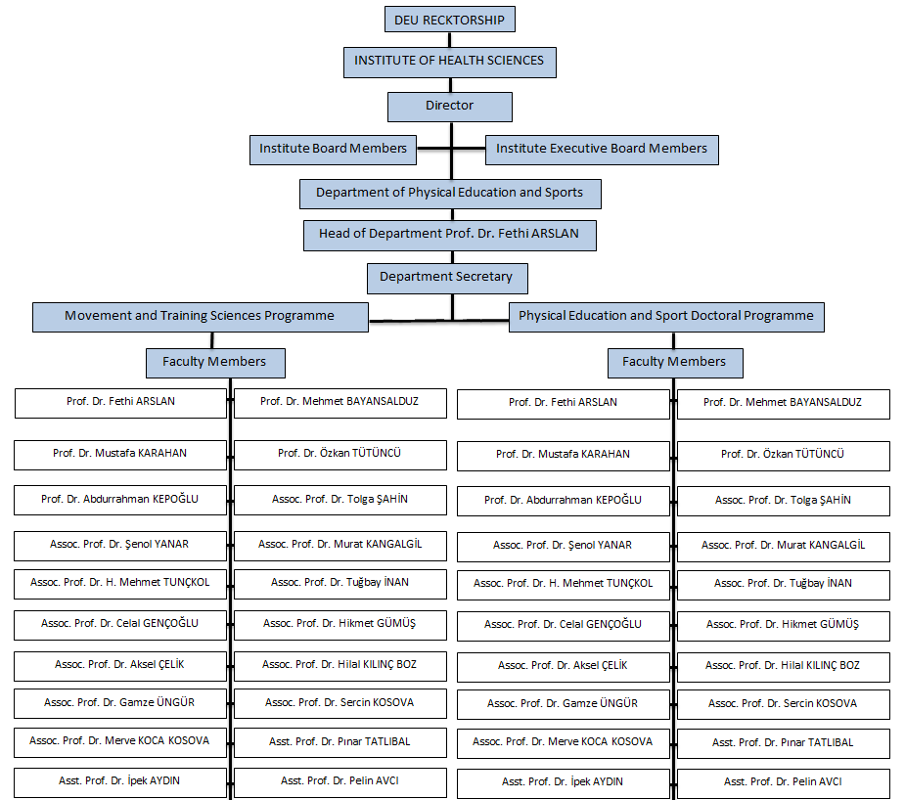
Organization Chart

Slide 4
Movement and Training Sciences Programme
Movement and Training Science Masters Program is started to education in 2011 - 2012 academic year within the Institute of Health Sciences with the objective of training expert Sport Scientists. Length of the programme is 4 semesters, 2 of them consisting of lectures and 2 of them thesis. Program language is Turkish.

Slide 5
Specific Admission Requirements
First Cycle Degree in the same or in related disciplines, Transcript, Acceptable score on ALES (Academic Personnel and Graduate Education Entrance Exam) or Equivalent GRE, GMAT score. Acceptable score on Language Proficiency Tests. Acceptable weighted score based on the first cycle cumulative grade point average (GPA) and ALES score. The exceptions to the requirements of ALES and Foreign Language Proficiency scores is announced by the Graduate School. International student admission requirements are decided by the Graduate School Executive Committee.

Slide 6
Specific Admission Requirements
It is required to have an ALES score of 55 from the score type of the program applied for or an equivalent score determined by the Senate from the GRE or GMAT exams.

Slide 7
Specific Admission Requirements
In application, it is mandatory to get at least 55 points from the foreign language proficiency exam conducted by Dokuz Eylül University School of Foreign Languages (validity period is 3 years from the exam date) or to get at least 50 points from the central foreign language exams (validity period is, if stated on the Foreign Language Certificate, this period is from the exam date; if not specified, it is the period determined by the CoHE from the exam date) accepted by CoHE or to get a score equivalent to this score from international foreign language exams whose equivalence is accepted.

Slide 8
Qualification Requirements and Regulations
Movement and Training Sciences Programme
Course Period
Thesis Period
Courses
54 ECTS
Thesis work
60 ECTS
Specialization
4 ECTS
Seminar
2 ECTS
Requirement | Grade
Cumulative grade point average | At least 2,50/4,00
Grade for all courses | At least CB (75/100)

Slide 9
Profile of the Programme
The objectives of this programme are;
to provide knowledge about movement and training sciences
to develop of essential data, ability and attitude of training profession prestige to analyzing vocational problems in the field of movement and training sciences
to utilize of modern technology at sports
to train technical and tactical skills for specific sport branches by usage of appropriate tuition methods in sport sciences

Slide 10
Fall Semester Courses
Faculty Member | Courses Given
Prof. Dr. Fethi ARSLAN (Head of Department of Physical Education and Sports) | -
Prof. Dr. Mehmet BAYANSALDUZ | BSH 5541 Turkey's Administrative Structure and Organization of Sports BSH 5098 Speciality Area
Prof. Dr. Mustafa KARAHAN | -
Prof. Dr. Özkan TÜTÜNCÜ | -
Prof. Dr. Abdurrahman KEPOĞLU | BSH 5099 Thesis Study BSH 5098 Speciality Area
Assoc. Prof. Dr. Tolga ŞAHİN | BSH 5533 Sport Management and Organization BSH 5098 Speciality Area

Slide 11
Fall Semester Courses
Faculty Member | Courses Given
Assoc. Prof. Dr. Şenol YANAR | BSH 5523 Training Science 1 BSH 5041 Physiological Bases of Motion, Force and Force
Assoc. Prof. Dr. Murat KANGALGİL | BSH 5098 Speciality Area BSH 5099 Thesis Study BSH 5545 International Comparisons in Physical Education and Sports Education BSH 5547 Movement Education and Play in Children BSH 5549 Principle Method Techniques in Sports Education
Assoc. Prof. Dr. Hulusi Mehmet TUNÇKOL | BSP 5527 Sport Sociology BSH 5543 Olympic Action: Historical Philosophy and Future
Assoc. Prof. Dr. Tuğbay İNAN | -

Slide 12
Fall Semester Courses
Faculty Member | Courses Given
Assoc. Prof. Dr. Celal GENÇOĞLU | BSH 5503 Exercise Physiology 1 BSH 5098 Speciality Area BSH 5099 Thesis Study
Assoc. Prof. Dr. Hikmet GÜMÜŞ | BSH 5098 Speciality Area BSH 5099 Thesis Study
Assoc. Prof. Dr. Aksel ÇELİK | BSH 5039 Children and Sports 1 BSH 5096 Seminar BSH 5098 Speciality Area
Assoc. Prof. Dr. Hilal KILINÇ BOZ | EFZ 5004 Measurement and Evaluation of Physical Performance BSH 5036 Anti Doping and Ethics in Sports
Assoc. Prof. Dr. Gamze ÜNGÜR | BSH 5098 Speciality Area BSH 5531 Sport Psychology
Assoc. Prof. Dr. Sercin KOSOVA | -

Slide 13
Fall Semester Courses
Faculty Member | Courses Given
Assoc. Prof. Dr. Merve KOCA KOSOVA | -
Asst. Prof. Dr. Pınar TATLIBAL | -
Asst. Prof. Dr. İpek AYDIN | -
Asst. Prof. Dr. Pelin AVCI | -

Slide 14
Spring Semester Courses
Faculty Member | Courses Given
Prof. Dr. Fethi ARSLAN (Head of Department of Physical Education and Sports) | BSH 5552 Learning and Teaching in Education: Field Practice
Prof. Dr. Mehmet BAYANSALDUZ | BSH 5540 Modern Sports Business
Prof. Dr. Mustafa KARAHAN | -
Prof. Dr. Özkan TÜTÜNCÜ | -
Prof. Dr. Abdurrahman KEPOĞLU | -
Assoc. Prof. Dr. Tolga ŞAHİN | BSH 5542 Total Quality Management in Sports BSH 5544 Human Relations in Sports Management BSH 5096 Seminar

Slide 15
Spring Semester Courses
Faculty Member | Courses Given
Assoc. Prof. Dr. Şenol YANAR | -
Assoc. Prof. Dr. Murat KANGALGİL | BSH 5546 Measurement and Evaluation in Physical Education and Sports BSH 5548 Use of Technology in Physical Education and Teaching
Assoc. Prof. Dr. Hulusi Mehmet TUNÇKOL | BSH 5527 Sport Sociology BSH 5543 Olympic Action: Historical Philosophy and Future BSH 5036 Anti Doping and Ethics in Sports
Assoc. Prof. Dr. Tuğbay İNAN | BSH 5535 Sport Marketing
Assoc. Prof. Dr. Celal GENÇOĞLU | BSH 5526 Exercise Physiology 2 BSH 5554 Performance Tests in Sports Sciences

Slide 16
Spring Semester Courses
Faculty Member | Courses Given
Assoc. Prof. Dr. Hikmet GÜMÜŞ | -
Assoc. Prof. Dr. Aksel ÇELİK | -
Assoc. Prof. Dr. Hilal KILINÇ BOZ | -
Assoc. Prof. Dr. Gamze ÜNGÜR | BSH 5531 Sport Psychology
Assoc. Prof. Dr. Sercin KOSOVA | -

Slide 17
Spring Semester Courses
Faculty Member | Courses Given
Assoc. Prof. Dr. Merve KOCA KOSOVA | -
Asst. Prof. Dr. Pınar TATLIBAL | BSH 5096 Seminar
Asst. Prof. Dr. İpek AYDIN | -
Asst. Prof. Dr. Pelin AVCI | -

Slide 18
Student Details
Year | Actively Studying Students | Graduated Students
2011 | 4 | -
2012 | 11 | -
2013 | 23 | -
2014 | 30 | -
2015 | 30 | -
2016 | 31 | -
2017 | 31 | 3
2018 | 21 | 6
2019 | 12 | 5
2020 | 20 | 2
2021 | 27 | 3
2022 | 30 | 3
2023 | 19 | 7

Slide 19
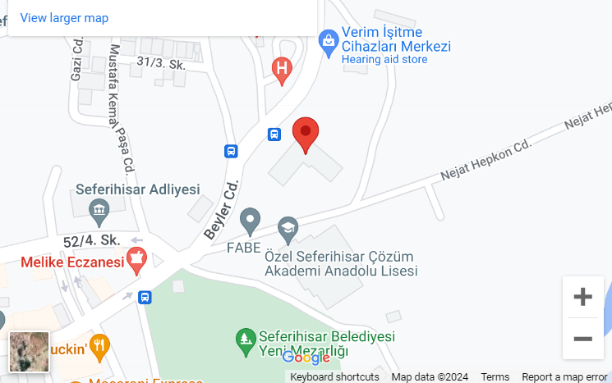
Contact Information
Address: Turabiye Mah. Beyler Cad. No:4 Seferihisar/İzmir
Phone number: +90 232 743 51 10

