Slide 1
Dokuz Eylül University Health Sciences Institute
Department of Sleep and Conscious States
Basic and Clinical Sleep and States Of Consciousness Master Programme General Structure and Courses
Dokuz Eylül University Faculty of Medicine, 35340 Balçova/İzmir
0 232 412 44 81

Slide 2
Clinical Sleep and States Of Consciousness Master Programme General Structure
More and more research is being done on the sleep process to learn more about how the body works and about diseases. It is the goal of this program to teach modern people about the brain and how it works during sleep and other states of consciousness (like coma, anesthesia, etc.), as well as about biological rhythms, monitoring, brain and measurement methods, sleep quality, and sleep disorders.
In order to reach these goals, the program works with leading researchers in engineering, neurology, psychiatry, anesthesia, biophysics, physiology, chest diseases, and ear-nose-throat and neurology.

Slide 3
Basic and Clinical Sleep and States Of Consciousness Master Programme Research Areas
Brain Asymmetry
(lateralitty)
Brain oxygenation
Thermal behaviours
Memory
Brain under different conscious states (sleep, wakefulness, anesthesia)
Evoked Potentials (visual, auditory, somatosensory)
Event-related Potentials and Oscillations

Slide 4
Clinical Sleep and States Of Consciousness Master Programme Outcomes
Have knowledge of the clinical history of sleep medicine, mechanisms of sleep and pharmacology of medication used in sleep medicine.
Have clinical knowledge of the physiological changes which occur in sleep, sleep systems and changes observed in sleep.
Have clinical knowledge on the changes which occur in various consciousness states and their assessment techniques.
Have knowledge on sleep disorders.
Have knowledge on circadian rhythm and its disorders.
Have professional clinical skills.
Have the ability to work as part of a group and carry out multidisciplinary studies.
Have knowledge on motorization during sleep and various consciousness states.
Have knowledge on the basic principles of old and new imaging techniques used in different consciousness states.
Have clinical knowledge on neuroanatomy.
Have knowledge on definitions in neurobiology and cognition.
Have knowledge on ethical action and communication skills with patients with sleep disorders and their relatives.
Have knowledge on neurological illnesses encountered in the clinical setting and sleep disorders associated with them.
Have knowledge on the features of cognitive psychology, memory concepts and research methods
Have knowledge on the various methods of assessment of different sensory perceptions and their relation to other cognitive processes.
Have knowledge on basic methods of signal processing and basic skill in data analysis.

Slide 5
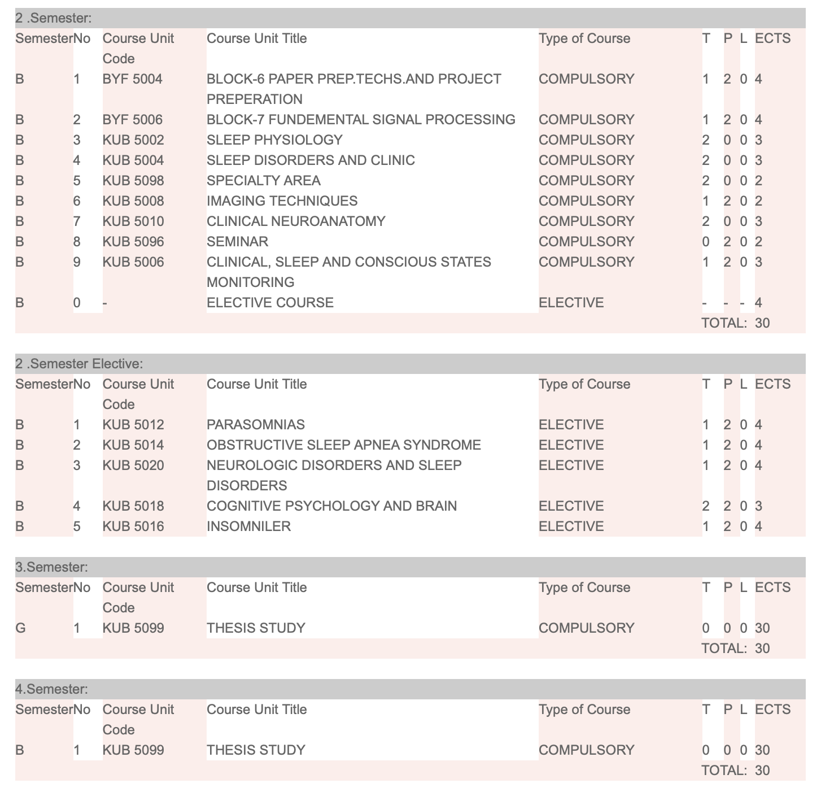
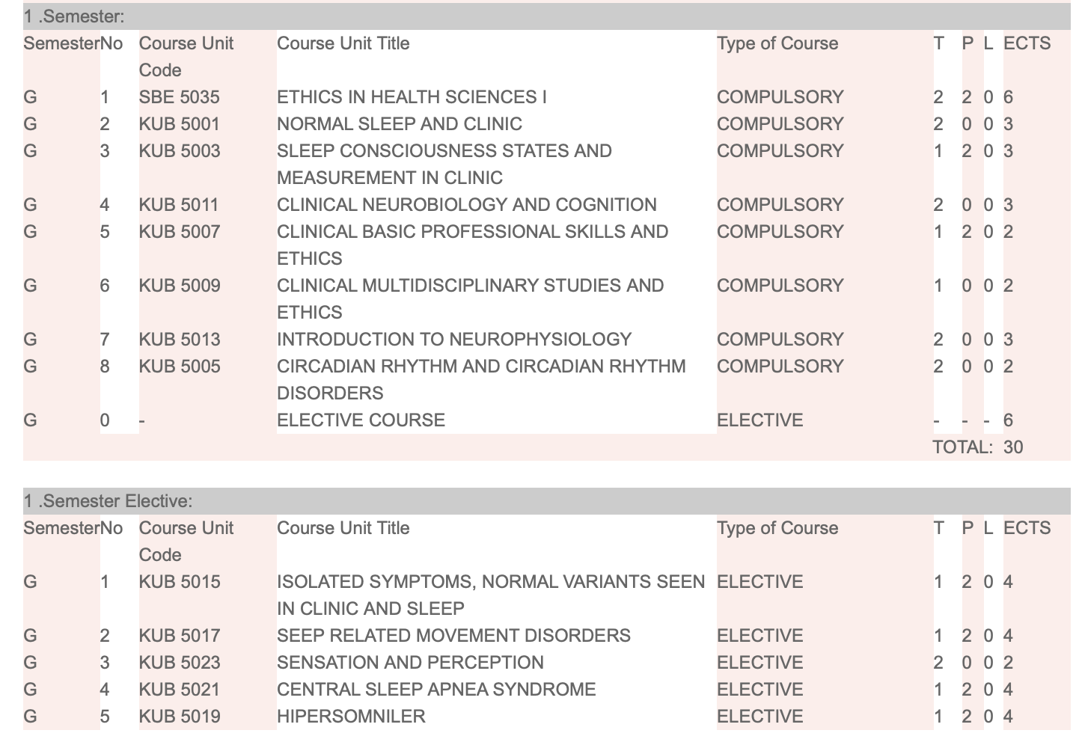
Clinical Sleep and States Of Consciousness Master Programme Courses

Slide 6
Basic Sleep and States Of Consciousness Master Programme Outcomes
Have basic knowledge on the history of sleep medicine, mechanisms of sleep and genetic basis of sleep.
Have competence in assessment techniques used in different consciousness states and pathologic processes.
Have competitive knowledge on circadian rhythms and their effects, physiological changes in sleep and sleep systems.
Basic knowledge on sleep disorders.
Have knowledge on motorization in different consciousness states and sleep
Have basic knowledge in cognition and neurobiology.
Have basic knowledge in neuroanatomy
Have basic knowledge in neurophysiology.
Be competent on basic principles of imaging techniques used in different consciousness states.
Have knowledge on the various methods of assessment of perception in five sensory modes and their relation to other cognitive processes.
Have knowledge on sleep disorders and sleep disorders in relation to other illnesses.
Have knowledge on basic methods of signal processing and basic skill in data analysis.
Have basic knowledge on cognitive psychology, psychological tests and memory concepts

Slide 7
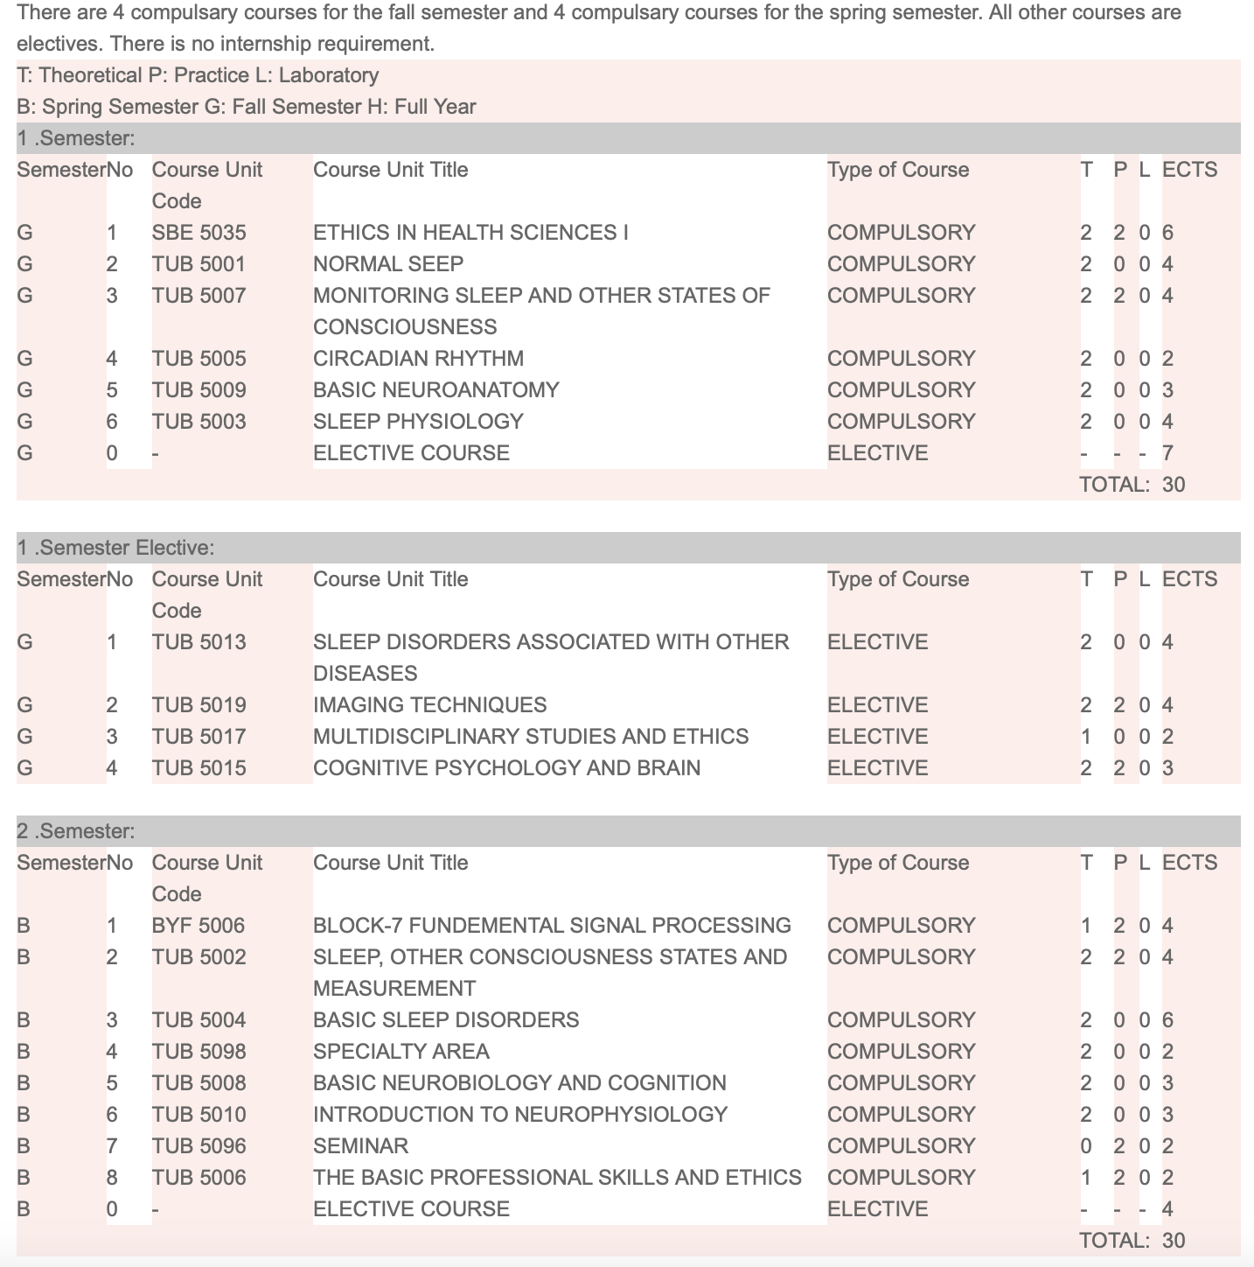
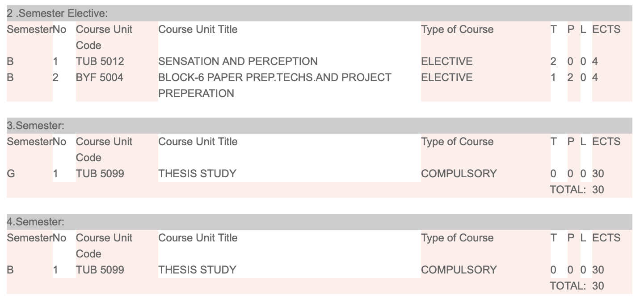
Basic Sleep and States Of Consciousness Master Programme Courses

Slide 8
Head of Department of Sleep and Conscious States
Assoc. Prof. Dr. Çağdaş Güdücü
cagdas.guducu@deu.edu.tr
0232 412 44 81
Dokuz Eylül Üniversitesi Tıp Fakültesi Yerleşkesi, 35340 Balçova/İzmir
0 232 412 44 81

