Slide 1
Dokuz Eylul University Institute of Health Sciences Doctorate Program of Molecular Pathology
Prof Dr Sülen Sarıoğlu
Prof Dr Banu Lebe
Prof Dr Safiye Aktaş
Prof Dr Özgül Sağol
Prof Dr Burçin Tuna
Prof Dr Kutsal Yörükoğlu
Prof Dr Sermin Özkal
Prof Dr Çağnur Ulukuş
Doç Dr Merih Güray
Doç Dr Duygu Gürel
Prof Dr Sefa Kızıldağ

Slide 2
Examinations Required for Routine Pathology Report
histochemistry
immunohistochemistry
electron microscopy
Molecular Pathology
Holistic Pathology Report

Slide 3
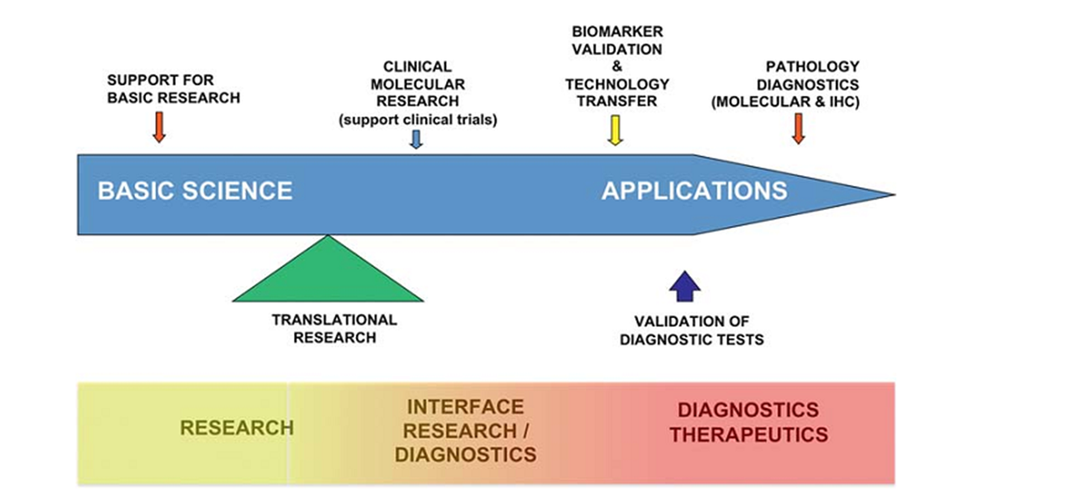
Diagnostic medicine – Question to Answer
What kind of cancer is this?
How can I treat this?
Which drug?
Most effects - least side effects

Slide 4
Molecular Pathology Methods
In situ hybridization
(chromogen, silver, gold, fluorescent, double, multiple) (DNA or RNA)
Polymerase chain reaction (Real time PCR, Reverse transcriptase PCR, electrophoresis)
Sequencing
(Sanger, Pyro, Next Generation)
Microarray

Slide 5
Department of Molecular Pathology
It is a multidisciplinary department established within the SBE institute in 2018 (10.01.2018) with the approval of YÖK.
Our department includes faculty members from the Departments of Pathology, Basic Oncology Genetics, Molecular Biology and Genetics.
The duration of the program is 8 semesters and the maximum completion time is twelve semesters.
The language of instruction of the program is Turkish. 8 Professors and 4 Associate Professors are involved in the execution of the program.

Slide 6
Molecular Pathology PhD Program Aims
To train individuals with advanced basic and current theoretical knowledge in the field of molecular pathology; To equip students with advanced laboratory techniques and scientific skills such as advanced project writing, project management, data collection and analysis, international scientific communication, and scientific article writing, which prepare them for independent research.

Slide 7
Conditions
To be Medical Pathology Specialist (Specialization certificate) and having a certificate of achievement in foreign language exams in accordance with SBE requirements
4 years, 2 semesters in 1 year, 15 weeks each semester. 240 ECTS. PhD program; It consists of at least twenty-one credits taken from the course groups specified in the teaching plans, at least seven courses, seminar, qualifying exam, thesis proposal, area of ​​expertise course, and thesis work.

Slide 8
PART TIME PROGRAM
Students must provide 240 ECTS credits (78 ECTS courses, 12 ECTS specialization area and 150 ECTS thesis work) to graduate. In order to be successful in each course, their grade point average must be at least 2.50 / 4.00.
The measurement and evaluation methods applied for each course are defined in the Course Introduction Form prepared by the relevant faculty member(s) and included in the Information package. Regarding exams and course success grades, the relevant articles of the DEU Postgraduate Education and Training Regulation and the Health Sciences Institute Postgraduate Education and Examination Application Principles are applied. In order to be successful in the course, a minimum score of 75 (CB) is required.

Slide 9
LECTURES
Basic Mechanisms for Molecular Pathology
Laboratory Methods for Molecular Pathology
Bioinformatics for Molecular Pathology
Molecular Pathological Mechanisms of Diseases
Biomarkers in Molecular Pathology
In Silico Research Methods in Molecular Pathology

Slide 11
Program Gains
high level of knowledge about research data, patient diagnosis, and what needs to be done regarding the material and individual safety and accuracy of his employees.
the ability to integrate macroscopic evaluation methods with sampling, tissue and cell processing processes, and polecular pathological processes.
Applies and evaluates immunohistochemistry, immunofluorescence, RNA and DNA isolation, polymerase chain reaction and its uses in molecular pathology, sequencing in situ hybridization and microarraying methods.
good knowledge of the molecular pathological mechanisms of inflammatory, degenerative and neoplastic diseases at the molecular, cellular, organ and organ systems levels.
Has a good knowledge of biomarkers and their effectiveness in research, diagnosis and treatment.
has a good knowledge of biomarkers in cells and cell damage, inflammatory, metabolic, degenerative, neoplastic diseases and transplanted cells and organs.
Has basic knowledge of modern bioinformatics and databases.
has a high-level perspective on molecular information.
has high-level bioinformatics application skills in research and clinical field in the field of molecular pathology.
has a high level of knowledge and skills regarding scientific research methods, ethics, critical reading, research methods and statistical methods.
has a high level of skill in written and verbal presentation of scientific data/results.

