Slide 1

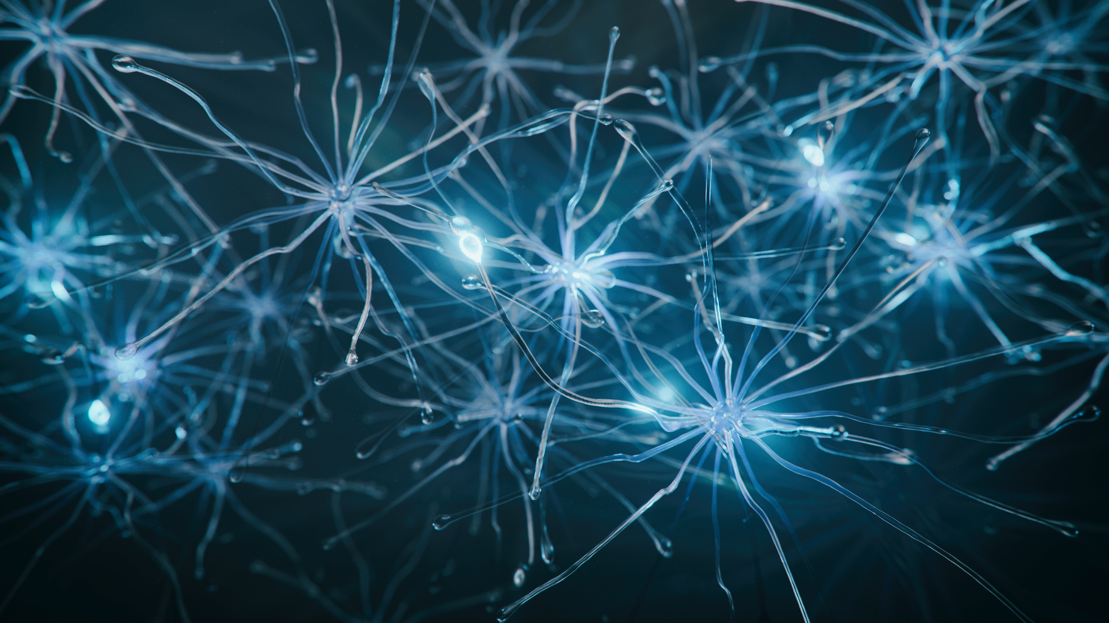



Dokuz Eylül University Institute of Health Sciences
Department of
Molecular Medicine
Dokuz Eylül University Institute of Health Sciences, Faculty of Medicine Ground Floor, 35340 Balçova/İzmir
https://molekulertip.deu.edu.tr/

Slide 2
Members of Molecular Medicine
Academic Members | Contact Information | Office
Prof. Dr. Oğuz ALTUNGÖZ Chair Person | oguz.altungoz@deu.edu.tr | Faculty of Medicine Department of Medical Biology
Prof. Dr. Gül Hüray İŞLEKEL | huray.islekel@deu.edu.tr | Faculty of Medicine Department of Medical Biochemistry
Prof. Dr. Ayfer ÜLGENALP | ayfer.ulgenalp@deu.edu.tr | Faculty of Medicine Department of Medical Genetics
Prof. Dr. Nur ARSLAN | nur.arslan@deu.edu.tr | Internal Medicine Department Of Pediatrics Pediatric Gastroenterology-hepatology And Diet & Pediatric Metabolic Diseases
Prof. Dr. Mukaddes GÜMÜŞTEKİN | gumustek@deu.edu.tr | Faculty of Medicine Department of Medical Pharmacology
Prof. Dr. Ahmet Okay ÇAĞLAYAN | ahmetokay.caglayan@deu.edu.tr | Faculty of Medicine Department of Medical Genetics
Prof. Dr. Zahide ÇAVDAR | zahide.cavdar@deu.edu.tr | Institute of Health Sciences Department of Molecular Medicine
Assoc. Prof. Yasemin SOYSAL | yasemin.soysal@deu.edu.tr | Institute of Health Sciences Department of Molecular Medicine
Assoc. Prof. Gamze TUNA | gamze.tuna@deu.edu.tr | Institute of Health Sciences Department of Molecular Medicine
Assist. Prof. Mehtap YÜKSEL EĞRİLMEZ | mehtap.yüksel@deu.edu.tr | Institute of Health Sciences Department of Molecular Medicine
Assist. Prof. Özlenen ŞİMŞEK PAPUR | ozlenen.simsek@deu.edu.tr | Institute of Health Sciences Department of Molecular Medicine

Slide 3
Research Areas
Cancer
Wound healing
Oxidative DNA damage and DNA repair
Mass Spectrometry
Extracellular matrix proteolysis and ischemia-reperfusion injury
Cardiovascular and metabolic diseases
Examination of genetic diseases by cytogenetic and molecular techniques
Autoimmune diseases and their molecular mechanisms

Slide 4
MOLECULAR MEDICINE MASTER PROGRAM
Program history | The Department of Molecular Medicine was founded in 2009 as a multidisciplinary department under the umbrella of the Graduate School of Health Sciences.
Program aim | The aim of this program is to train pupils who have basic and current theoretical and laboratory knowledge in molecular medicine and related fields.
Graduation requirements | Second Cycle (Masters Degree) Program with thesis is comprised of courses (at least 54 ECTS), a seminar (2 ECTS), and field study (4 ECTS) and thesis (60 ECTS) credits. In total 120 ECTS credits should be obtained. Students should obtain minimum Cumulative Grade Point Average (CGPA) of 2.50/4.00 and should complete all the courses with at least CB / S / TP grades.
Program duration | The program is a total of four semesters of which two semesters of courses and two semesters of thesis.
Program language | Turkish
Employment of graduates | This degree enables the holder to exercise the profession in the public or private sector.
Courses catalog information page | https://debis.deu.edu.tr/ders-katalog/2023-2024g/eng/bolum_9484_eng.html

Slide 5
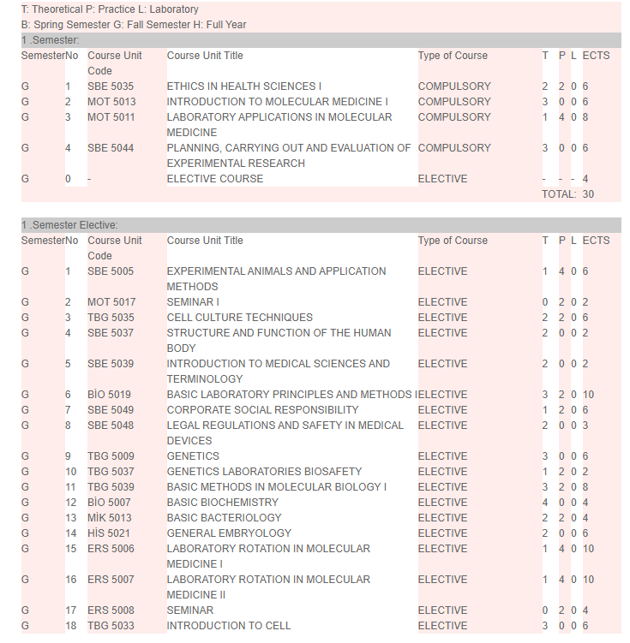
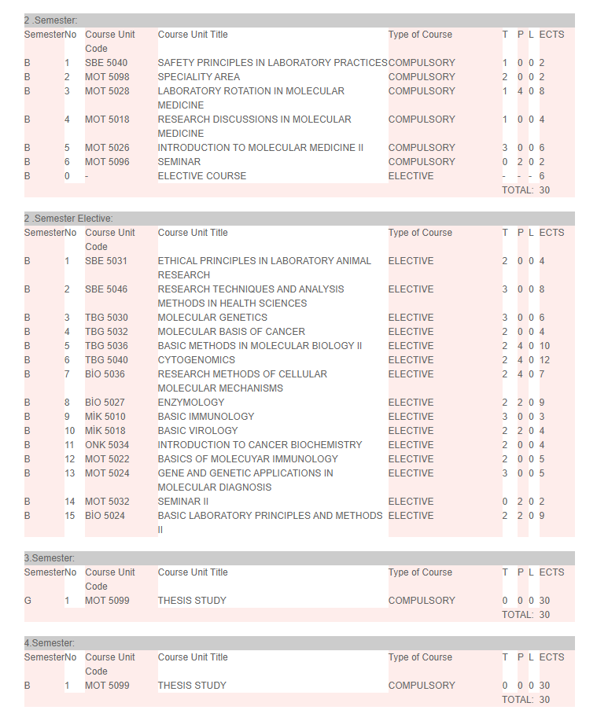
Master Programme Courses

Slide 6
MOLECULAR MEDICINE Ph.D PROGRAM (ORPHEUS MEMBER)
Program history | The Department of Molecular Medicine was founded in 2009 as a multidisciplinary department under the umbrella of the Graduate School of Health Sciences.
Program aim | The aim of this program is to train pupils who have basic and current theoretical and laboratory knowledge in molecular medicine and related fields.
Graduation requirements | Third Cycle (Doctorate Degree) Programme is comprised of courses, (at least 78 ECTS), field study (12 ECTS) and thesis (150 ECTS) in total 240 ECTS credits. Students must have a minimum Cumulative Grade Point Average (CGPA) of 2.50/4.00 and completed all the courses with at least CB / S / TP grades.
Program duration | It is a total of eight semesters. Three to five semesters of courses and study of thesis after proficiency exam.
Program language | Turkish
Employment of graduates | This degree enables the holder to exercise the profession in the public or private sector.
Courses catalog information page | https://debis.deu.edu.tr/ders-katalog/2023-2024g/eng/bolum_9485_eng.html

Slide 7
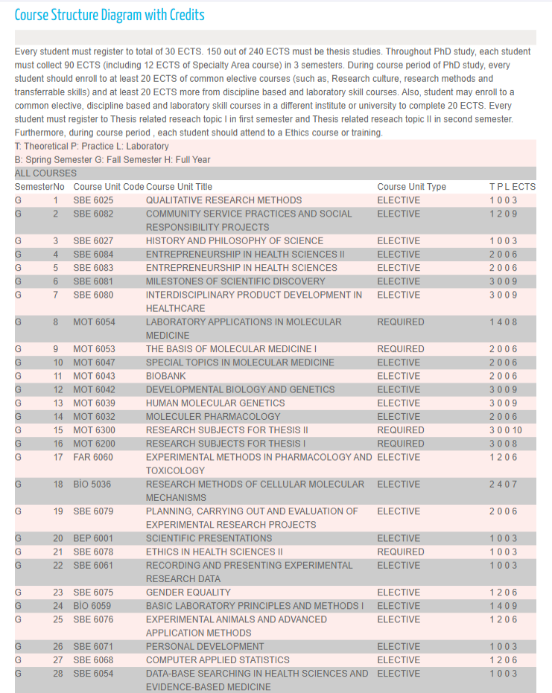
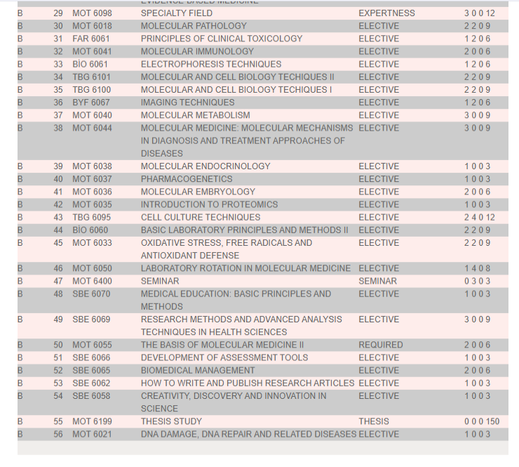
Molecular Medicine Doctorate Programme Courses

Slide 8
Contact Information
Programme Chair
Prof. Dr. Oğuz ALTUNGÖZ
E-mail: oguz.altungoz@deu.edu.tr
Programme Secretary
Ebru MÜFTÜOĞLU
E-mail: ebru.muftuoglu@deu.edu.tr
(+90)232-412- 2612

