Slide 1



HISTORY
2004. Department of Laboratory Animal Science was established by Prof. Dr. Osman YILMAZ. The first Laboratory Animal Science Master Degree (MSc) Programme in Turkey was started under the umbrella of DEU Institute of Health Sciences.
2011. The first PhD program in Laboratory Animal Science in Turkey started at DEU HSI
Dokuz Eylul University Institute of Health Sciences Laboratory Animal Science
Department

Slide 2
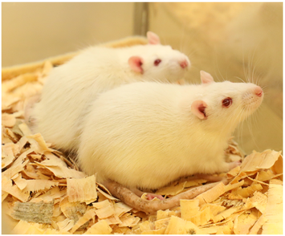
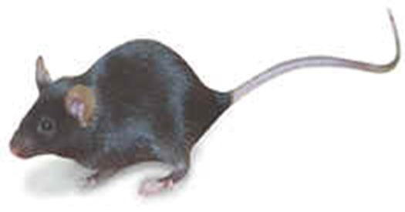
Laboratory Animal Science is a field of science that strives to create the most appropriate conditions for the production, breeding, housing and use of laboratory animals. This field is an emerging discipline that aims to improve not only the ethical and effective use of animals used in scientific research but also the reliability and reproducibility of studies conducted with these animals.
DEU HSI Laboratory Animal Science Department
Definition and Objectives
Laboratory Animal Science is based on the "3R Principle" (Reduction, Refinement, Replacement). This principle aims to reduce, refine and, if possible, replace laboratory animal experiments with other methods.

Slide 3
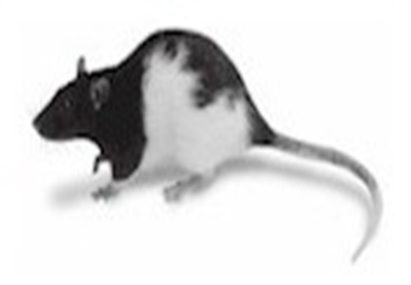
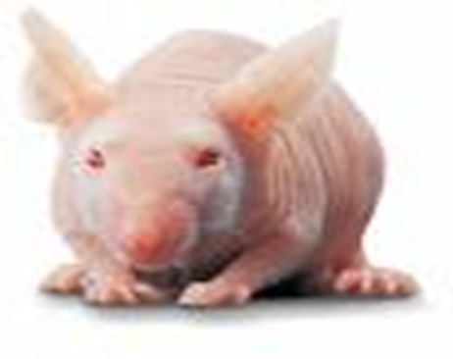
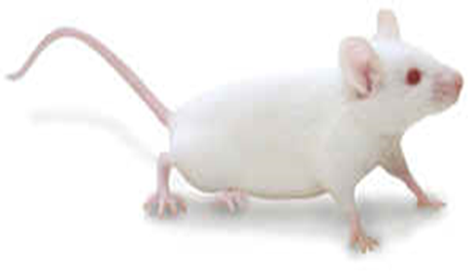
Laboratory Animal Science focuses on the identification, improvement and implementation of animal welfare standards. Within this framework, it aims to ensure the proper care and use of laboratory animals. Therefore, it is aimed to ensure the correct use of animal models in biomedical research and drug development processes.
DEU HSI Laboratory Animal Science Department
Education and Training
Researchers are trained by laboratory animal specialists to ensure full compliance with ethical standards in their procedures. This training includes topics such as respecting the rights of animals, minimizing animal stress and suffering, and exploring alternative methods.
In addition, laboratory animal science specialists and assistants ensure more accurate design and planning of experimental animal studies with the training programms they complete in this field. One of the main objectives of laboratory animal science education is to develop laboratory animal technologies in accordance with animal welfare.

Slide 4
Prof. Dr. Osman YILMAZ (Head of Department)
Prof. Dr. M. Ensari GÜNELİ
Prof. Dr. Ali Necati GÖKMEN
Prof. Dr. Çetin PEKÇETİN
Prof. Dr. Nergiz DURMUŞ SÜTPİDELER
Prof. Dr. Zekiye ALTUN
DEU HSI Laboratory Animal Science Department
Academic Staff

Slide 5
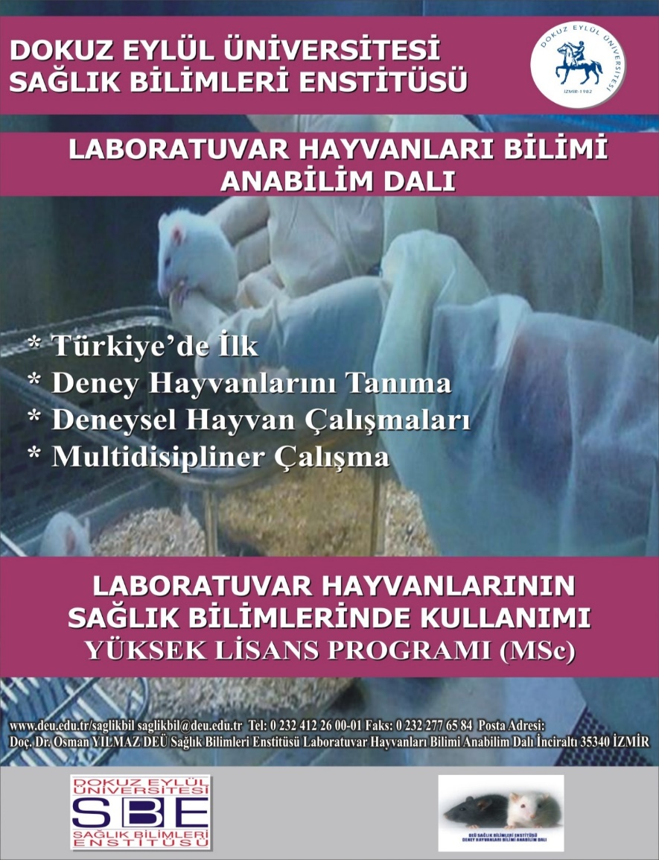
DEU HSI Laboratory Animal Science Department
MSc Programme Application Requirements
To be graduated from one of the undergraduate programmes of Veterinary Medicine, Medicine, Dentistry, Pharmacy or Biology.
To have at least 55 points from ALES exam,
It is necessary to have at least 60 points or equivalent score from the central foreign language exams accepted by Council of Higher Education in Turkey (CoHe/YÖK)

Slide 6
DEU HSI Laboratory Animal Science Department
PhD Programme Application Requirements
Those who apply to the doctorate programme with a master's degree with thesis must have a master's degree with thesis, and a minimum grade point average of at least 80 in the 100 system or at least 3.00 in the 4.00 system or equivalent.
Those who have at least ten semesters of undergraduate education, excluding faculties of medicine, dentistry, veterinary medicine, pharmacy and preparatory classes, are considered to have a master's degree.
To have at least 60 points from ALES exam,
It is necessary to have at least 60 points or equivalent score from the central foreign language exams accepted by Council of Higher Education in Turkey (CoHe/YÖK)

Slide 7
PhD programme graduates
Efsun Kolatan, Bio, MSc
Gonca Kamacı, DVM
Meryem Çalişir, Bio, MSc
Aslı Çelik, DVM, MSc
PhD Programme students
Nazan Baksi, DVM
H. Zeynep Koşar, DVM
DEU HSI Laboratory Animal Science Department
Graduates and Students
MSc programme graduates
Efsun Kolatan, Bio
Aslı Çelik, DVM
Nazım Güreş, MD
Semih Gülle, MD
MSc programme students
There are currently no registered students.

Slide 8
DEU HSI Laboratory Animal Science Department
Job Opportunities of Graduates
Graduates can find job opportunities in:
State and Private Experimental Animal Facilities Accredited by the Turkish Ministry of Agriculture and Forestry (205),
Being an academician in universities (The field of associate professorship in the Basic Field of Health Sciences has been defined by the Presidency of the Interuniversity Board of the Republic of Turkey)
Veterinary Research and Control Laboratories,,
Experimental Research Centers of national or international pharmaceutical companies,
In companies developing national or international laboratory animal technologies,
In companies developing laboratory animal cages, feed and cage enrichment materials,
In companies developing experimental animal devices and equipment (respirator, behavioral and surgical equipment, etc.)

Slide 9
DEU HSI Laboratory Animal Science Department
Academic Activities
2nd National Laboratory Animal Science Symposium Izmir, 2010
FELASA Accredited International Course, İzmir, 2013
5th National Laboratory Animal Science Congress, Istanbul, 2023
National training courses in laboratory animal science (organised twice a year)

