Slide 1
Postgraduate Programs of Department of Medical Pharmacology
Dokuz Eylül University Institute of Health Sciences

Slide 2
Members of the Department of Medical Pharmacology
Professor Mukaddes Gümüştekin- Department of Medical Pharmacology, Department of Clinical Pharmacology - Head of Department
Professor Yeşim Tunçok- Department of Medical Pharmacology, Department of Clinical Pharmacology, Department of Clinical Toxicology
Professor Ayşe Gelal- Department of Medical Pharmacology, Department of Clinical Pharmacology
Professor Şule Kalkan- Department of Medical Pharmacology, Department of Clinical Toxicology
Professor Nergiz Durmuş Sütpideler- Department of Medical Pharmacology
Professor M. Aylin Arıcı- Department of Medical Pharmacology, Department of Clinical Pharmacology
Associated Professor Nil Hocaoğlu Aksay- Tıbbi Farmakoloji Anabilim Dalı Klinik Toksikoloji Bilim Dalı

Slide 3
Graduate Programs
Master's Programs
Pharmacology
Toxicology
Clinical Pharmacology
Doctoral Programs
Pharmacology
Toxicology

Slide 4
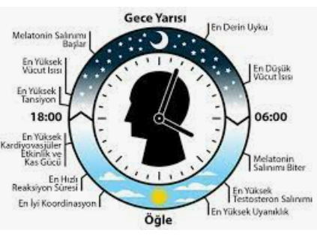
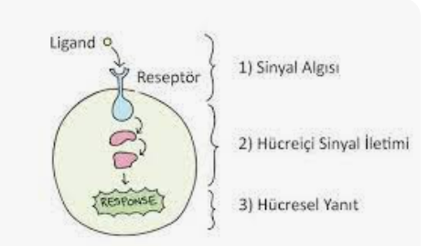
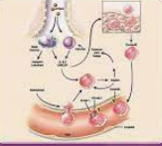
Research Areas
Clinical pharmacology
Clinical drug research
Clinical toxicology
Cardiovascular pharmacology and toxicology
Signaling pathways in cancer
Endocrine system pharmacology
Circadian rhythm
Urogenital system pharmacology

Slide 5
PHARMACOLOGY MASTER PROGRAM
Program History | It has been accepting students since 2000
Program Aim | To train individuals with basic knowledge of basic pharmacology
Program achievements | Knowing the basic definitions of pharmacokinetics and pharmacodynamics Having knowledge about laboratory principles related to pharmacology, being able to plan, perform and interpret experiments. Gaining the ability to read and interpret literature and adapt to changes in science Gaining the ability to work in hospitals and centers related to reporting drugs and their side effects Gain the ability to present posters and write articles about your profession at congresses Gaining the ability to work in a group and be ethically responsible
Program duration | It is a total of 4 semesters, 2 semesters of courses and 2 semesters of thesis.
Program language | Turkish
Employment of graduates | Can work in the field of Pharmacology in the public and private sectors Can apply to doctoral programs

Slide 6
TOXICOLOGY MASTER PROGRAM
Program History | It has been accepting students since 2006
Program Aim | To train individuals with basic knowledge about toxicology
Program achievements | Knowing the basic definitions of Toxicology and Clinical Toxicology Having knowledge about laboratory principles related to toxicology, being able to plan, perform and interpret experiments. Having knowledge about Laboratory Analysis in Clinical Toxicology Having knowledge about the Principles of Emergency Approach to the Poisoned Patient Having knowledge about special topics in toxicology Gaining the ability to read and interpret literature and adapt to changes in science Gain the ability to present posters and write articles about your profession at congresses Gaining the ability to work in a group and be ethically responsible
Program duration | It is a total of 4 semesters, 2 semesters of courses and 2 semesters of thesis.
Program language | Turkish
Employment of graduates | Can work in the field of toxicology Can apply to doctoral programs

Slide 7
MASTER'S DEGREE IN CLINICAL DRUG RESEARCH
Program History | It has been accepting students since 2014
Program Aim | To train individuals with basic knowledge about clinical drug research
Program achievements | Knowing the basic concepts of clinical pharmacology and being able to use them in professional life Knowing the national and international regulations in force for clinical drug research Ability to understand the basic features of clinical drug research Having information about clinical drug research in special groups Gaining the ability to read and interpret literature and adapt to changes in science Gain the ability to present posters and write articles about your profession at congresses Gaining the ability to work in a group and be ethically responsible
Program duration | It is a total of 4 semesters, 2 semesters of courses and 2 semesters of thesis.
Program language | Turkish
Employment of graduates | Can work in clinical drug research at universities or pharmaceutical companies Can apply to doctoral programs

Slide 8
PHARMACOLOGY PhD PROGRAM
Program History | It has been accepting students since 1998
Program Aim | To train individuals with basic knowledge of basic pharmacology
Program achievements | Having knowledge about the analysis of pharmacological data Having knowledge about experimental methods in pharmacology and gaining the ability to provide consultancy on these issues Ability to plan and conduct research in which experimental methods in pharmacology can be used together with other experimental methods (such as molecular biology, histology and pathology). Having knowledge about special experimental methods in pharmacology and being able to find solutions to problems by using this knowledge when necessary. Gaining the ability to read and interpret literature and adapt to changes in science Gaining the ability to work in hospitals and centers related to reporting drugs and their side effects Gain the ability to present posters and write articles about your profession at congresses Gaining the ability to work in a group and be ethically responsible
Program duration | It is a total of 8 semesters, 4 semesters of courses and 4 semesters of thesis.
Program language | Turkish
Employment of graduates | Can work as an expert in the field of Pharmacology in the public and private sectors

Slide 9
TOXICOLOGY PhD PROGRAM
Program History | It has been accepting students since 2008
Program Aim | To train individuals with basic knowledge about toxicology
Program achievements | Knowing the basic definitions of Toxicology and Clinical Toxicology and being able to use them in professional life. Having knowledge about laboratory principles related to toxicology, being able to plan, perform and interpret experiments. Having knowledge and being able to interpret Laboratory Analysis in Clinical Toxicology Gaining the ability to read and interpret literature and adapt to changes in science To have knowledge about the Principles of Emergency Approach to the Poisoned Patient and to gain the ability to establish toxicology units in hospitals. Gain the ability to plan and conduct research on the epidemiological characteristics of poisonings Having knowledge about drug and substance addiction and providing consultancy on this subject Ability to make oral presentations, present posters and write articles about his/her profession at congresses. Having knowledge about special issues in toxicology and being able to provide solutions to problems by using this information when necessary.​
Program duration | It is a total of 8 semesters, 4 semesters of courses and 4 semesters of thesis
Program language | Turkish
Employment of graduates | Can work as an expert in Toxicology in the public and private sectors

