Slide 1
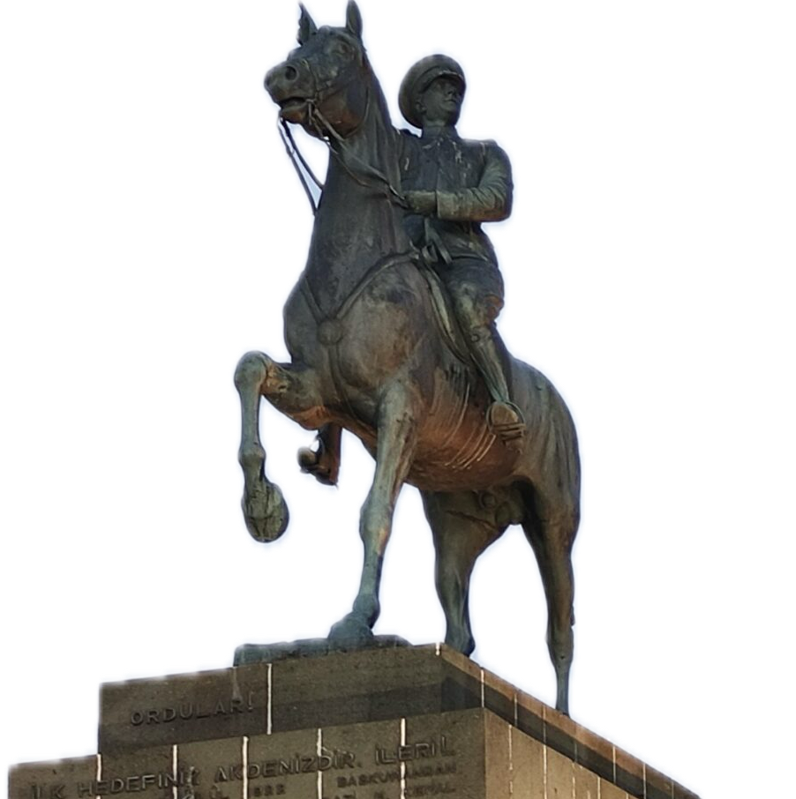
Program Content
Year of Foundation
Dokuz Eylul University Institute of Health Sciences Department of Dental Biomaterials Master’s Program
Purpose & Gains
Admission & Registration Conditions
Graduation Requirements

Slide 2
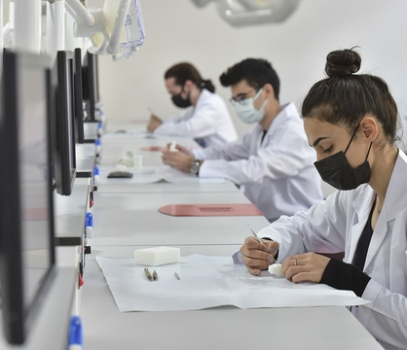
Admission & Registration Conditions
Year of Foundation
Graduation Requirements
Program Content
Purpose & Gains

Slide 3
Graduation Requirements
Purpose & Gains
Kabul ve Kayıt Koşulları
Admission & Registration Conditions
Program Content
Program İçeriği
Year of Foundation
Dental biomaterials master's program; It is a program belonging to the multidisciplinary department of Dokuz Eylül University Health Sciences Institute.
It admitted its first students in the spring semester of the 2021-2022 academic year.

Slide 4
Mezuniyet Koşulları
Programın Amacı ve Kazanımları
Kabul ve Kayıt Koşulları
Admission & Registration Conditions
Program Content
Program İçeriği
The duration of the program is 2 years in total, including 1 year of coursework and 1 year of thesis year.
The language of the program is Turkish.
There are 2 semesters a year, 16 weeks in each semester. There are a total of 120 ECTS credits.
Faculty members from eight departments within the faculty of dentistry provide training in this program.
Year of Foundation

Slide 5
Mezuniyet Koşulları
Programın Amacı ve Kazanımları
Purpose & Gains
Admission & Registration Conditions
Students with a dentistry faculty diploma will be accepted.
Students are required to have at least 55 points from the relevant branch (Numerical) of the Academic Personnel and Graduate Education Entrance Examination (ALES) (validity period is 5 years).
Students who will be admitted to the program are expected to know sufficient English to be able to follow and write academic publications, and the language requirement determined by the institute will also be taken into account.
ALES requirement is not required for dentistry specialty graduates' applications to the master's degree program.
Final acceptance depends on the evaluation of the relevant academic unit commission. Admission conditions for international students are decided by the Institute Board of Directors.
Program İçeriği
Program Content

Slide 6
Graduation Requirements
Mezuniyet Koşulları
Purpose & Gains
It is aimed to have up-to-date basic and clinical knowledge about dental biomaterials and to produce and develop new biomaterials in the field.
It is aimed to determine the needs of the health sector, create new projects in line with these deficiencies, and conduct interdisciplinary research in national/international projects.
It is expected that the student will have theoretical, practical and laboratory knowledge and skills that will be used in studies on dental biomaterials.
It is expected that they will be able to synthesize knowledge about biomaterials from different aspects and adapt them to new situations, and work in the fields of tissue engineering and regenerative medicine.
In order to access evidence-based information for the planning of scientific research, research techniques and statistical evaluation, the library aims to develop need-oriented projects, realize the projects, publish the results and present them at scientific events, by using e-resources.
Kabul ve Kayıt Koşulları
Admission & Registration Conditions

Slide 7
Graduation Requirements
Evaluation of courses is done using two midterm exams and a final exam, written assignments, presentations, seminars and projects. The minimum requirement for success is 75/100 points.
Master's Program with Thesis;
Courses (at least 54 ECTS)
Seminar (2 ECTS)
It consists of field study (4 ECTS) and thesis (60 ECTS) credits.
A total of 120 ECTS credits are required.
Students must have a GPA of at least 2.50/4.00.
Programın Amacı ve Kazanımları
Purpose & Gains

Slide 8
Department of Dental Biomaterials
Master’s Program
Mezuniyet Koşulları
Head of Department: Prof. Dr. Aliye Akcalı
aliye.akcali@deu.edu.tr

