Slide 1
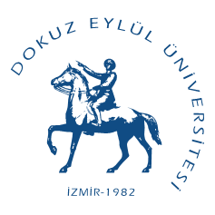
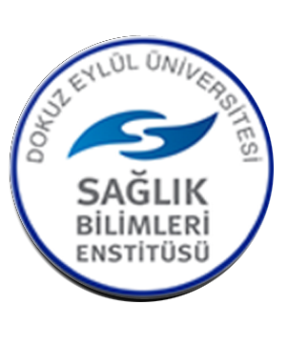
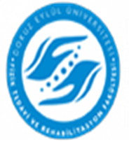
DOKUZ EYLÜL UNIVERSITY THE INSTITUTE OF HEALTH SCIENCES FACULTY OF PHYSICAL THERAPY AND REHABILITATION THE POSTGRADUATE DEPARTMENTS AND PROGRAMS

Slide 2
DEU., within the Institute of Health Sciences
There are two departments related to "Physical Therapy and Rehabilitation".
A- Department of Physical Therapy and Rehabilitation
It includes 1 master's degree (Physical Therapy and Rehabilitation Master's) and 1 doctoral program (Physical Therapy and Rehabilitation Doctorate)

Slide 3
A- Department of Physical Therapy and Rehabilitation
1- Physical Therapy and Rehabilitation Master's Program
The Physical Therapy and Rehabilitation Master's program was opened in 1993.
The aim of this program is to train physiotherapists who have theoretical knowledge and clinical practices in the field of physiotherapy, develop presentation skills, follow scientific developments in their field, and have research knowledge and skills in their field.

Slide 4
A- Department of Physical Therapy and Rehabilitation
2- Ph.D. Program in Physical Therapy and Rehabilitation
The Ph.D. program in Physical Therapy and Rehabilitation has been producing graduates with the title of doctor since 1996. Program courses are carried out at the Faculty of Physical Therapy and Rehabilitation located at Dokuz Eylul University Health Campus. The general purpose of the program is; Those who have grasped the philosophy of physiotherapy science, who can carry their knowledge and experience to relevant fields, who can develop new strategies in the fields of education and application or who have the ability to improve the existing system, who are innovative, research, question and transform the information they obtain into products will be able to work in institutions that provide education and health services in the field of Physiotherapy and Rehabilitation in our country and around the world. To train doctor physiotherapists.

Slide 5
B- Department of Physiotherapy and Rehabilitation
Within the scope of the Department of Physiotherapy and Rehabilitation, there are 5 master's degree programs that train expert physiotherapists in different specialties.
1- Geriatric Physiotherapy Master's Program
2- Musculoskeletal Physiotherapy Master's Program
3-Neurological Physiotherapy-Rehabilitation Master's Program
4- Orthopedic Physiotherapy Master's Program
5- Prosthesis-Orthotics Master's Program

Slide 6
1- Geriatric Physiotherapy Master's Program
Geriatric Physiotherapy Master's program was opened in 2010. The program aims to train professionals who have theoretical knowledge and clinical practices in the field of geriatric physiotherapy, who have presentation skills, who can follow scientific developments and who will contribute to this field with their scientific studies and applications. It aims to support the multidisciplinary team with physiotherapists specialized in the field. The program includes theoretical and practical compulsory and elective courses.

Slide 7
2- Musculoskeletal Physiotherapy Master's Program
Department of Musculoskeletal Physiotherapy was opened with the senate decision of 22.06.1999 and 250-6. Program courses are carried out at the Faculty of Physical Therapy and Rehabilitation located at Dokuz Eylül University Health Campus. The general purpose of the program is; Evaluates the patient using evidence-based information in the field of musculoskeletal physiotherapy, plans and implements the physiotherapy and rehabilitation program; To train expert physiotherapists in the field of musculoskeletal physiotherapy, who provide advice to children, adults, healthy people, the elderly and athletes to prevent injuries, improve physical health and give special exercise programs, and have the skills to plan and carry out a scientific study. Program; It consists of a total of 25 courses, 8 compulsory and 17 elective, which include theoretical knowledge and practices in the field of musculoskeletal physiotherapy, development of scientific research planning-conducting and presentation skills, and ethical principles.

Slide 8
3-Neurological Physiotherapy-Rehabilitation Master's Program
Neurological Physiotherapy-rehabilitation program started its postgraduate program in 2000. The purpose of this program is; To teach candidates how to use their skills in order to develop the science of physiotherapy and to ensure that they develop their basic knowledge in the field of physiotherapy. The program includes two compulsory courses each semester, as well as elective courses in different areas of neurological physiotherapy. Students can also choose courses from other departments and institutes

Slide 9
4- Orthopedic Physiotherapy Master's Program
Orthopedic Physiotherapy Master's program started its postgraduate program in 2010. The aim of this program is to gain knowledge about theoretical knowledge and clinical practices in the field of orthopedic physiotherapy, to develop presentation skills, to follow scientific developments in the field and to have research knowledge and skills in the field. The program includes 3 compulsory courses in the fall semester and 4 in the spring semester, as well as elective courses in different fields of orthopedic physiotherapy.In the program, where experienced faculty members specific to the field work, students are taught postgraduate level knowledge and skills about the planning of physiotherapy programs and different treatment approaches in orthopedics and traumatology diseases. It is aimed to carry out studies that guide scientific development and public health by using technology-supported current physiotherapy approaches in the field of orthopedic physiotherapy and rehabilitation.

Slide 10
5- Prosthesis-Orthotics Master's Program
Prosthetics Orthotics Master's program was opened in 2010. The aim of the program is to train professionals who can follow scientific developments and contribute to this field with their scientific studies and applications, to ensure that the disabled population can benefit from health and rehabilitation services at a higher rate, and that the rehabilitation team is supported by professionals competent in prosthetic orthosis application and development. The program includes compulsory theoretical courses, practical courses including laboratory and workshop applications, as well as elective courses.

