Slide 1
DEU Institute of Health Sciences Department of BIOMECHANICS (2004)

Slide 2
MULTIDISCIPLINARY DEPARTMENT BIOMECHANICS
ORTHOPEDICS
ELECTRONIC
BIOMATERIAL
MECHANICS
BIOLOGY

Slide 3
PROJECT AND RESEARCH PARTNERS
MEDICAL SCHOOL
ENGINEERING FACULTY(MACHINERY-ELECTRONICS-MATERIALS AND METALLURGY)
BASIC SCIENCES

Slide 4
PROJECT AND RESEARCH MAIN TITLES
BIOMECHANICS
BIOMATERIAL
BONE-CARTILAGE TISSUE ENGINEERING
BIOMECHATRONICS
CELL CULTURE
ORTHOPEDIC BIOMECHANICS

Slide 5
LABORATORIES
BIOMECHANICAL RESEARCH LAB.
MECHANICAL (DEU-EGE UNIV. MECH. ENG.)
MATERIALS AND METALLURGY (DEU)
ELECTRICITY ELECTRONICS (DEU)
CHEMISTRY (EGE UNIVERSITY)
MEDICAL BIOLOGY AND CELL CULTURE (DEU MEDICAL FACULTY)
MECHATRONICS (DEU)

Slide 6
Educational Programs
Master in Biomechanics
PhD in Biomechanics
PhD in Musculoskeletal Tissue Engineering

Slide 7
 | PATENTS
1 | BONE CLIPS SYSTEM FOR LONG BONE FRACTURES
2 | POSITIVE PRESSURE CONTROLLED FILTERED MOBILE BREATHING DEVICE
3 | MUCUS AND SLIME BASED GRADIENT LAYER BIOACTIVE TISSUE SCAFFOLD
4 | 3D BONE TUMOR AND METASTASIS MODEL IN SCAFOLD STRUCTURE
5 | STEM-FREE EXPANDABLE HIP PROSTHESIS
6 | AN ANKLE PROSTHESIS
7 | BIOFILAMENT COMPOSITION FOR 3D BIOPRINTING IN TISSUE ENGINEERING
8 | CONSTRUCTION OF ELECTROMECHANICAL FOOT ORTHOSIS
9 | DISTAL FEMORAL CONDYLE NAIL
10 | SMART TELEMETRIC HALLUX VALGUS SHOE
11 | CONTROLLED CONTINUOUS DYNAMIC COMPRESSION NAIL.
12 | CONTROLLED DYNAMIC COMPRESSION PLATE.
13 | EXPANDABLE BONE DETECTION NAIL SYSTEM.
14 | DYNAMIC VERTEBRAPLAST DEVICE
15 | A COMPOSITE MATERIAL DEVELOPED TO PROTECT FROM X-RAYS.
16 | MULTI-CHANNEL, SELF-GUIDED INTRAMEDULLAR DETECTION NAIL.
17 | COATING OF CALCIUM PHOSPHATE ON TI6AI4V WITH BODY FLUID SOLUTION BUFFERED WITH NA-LACTATE AND LACTIC ACID
18 | TISSUE HARDNESS MEASURING DEVICE
19 | INTRAMEDULLAR FIXATION NAIL
20 | PLATE STRUCTURE FOR FRACTURE FIXATION
21 | HIP JOINT PROSTHESIS
22 | BONE INTRAMEDULLAR DETECTION NAIL
23 | PLATE STRUCTURE FOR FRACTURE FIXATION
24 | A COMPOSITION FOR THE TREATMENT OF CHRONIC WOUNDS
25 | LOAD DAMPING NAIL.
26 | TMTS TURKISH MUSCULO SKELETAL TUMOR SYSTEM.

Slide 8
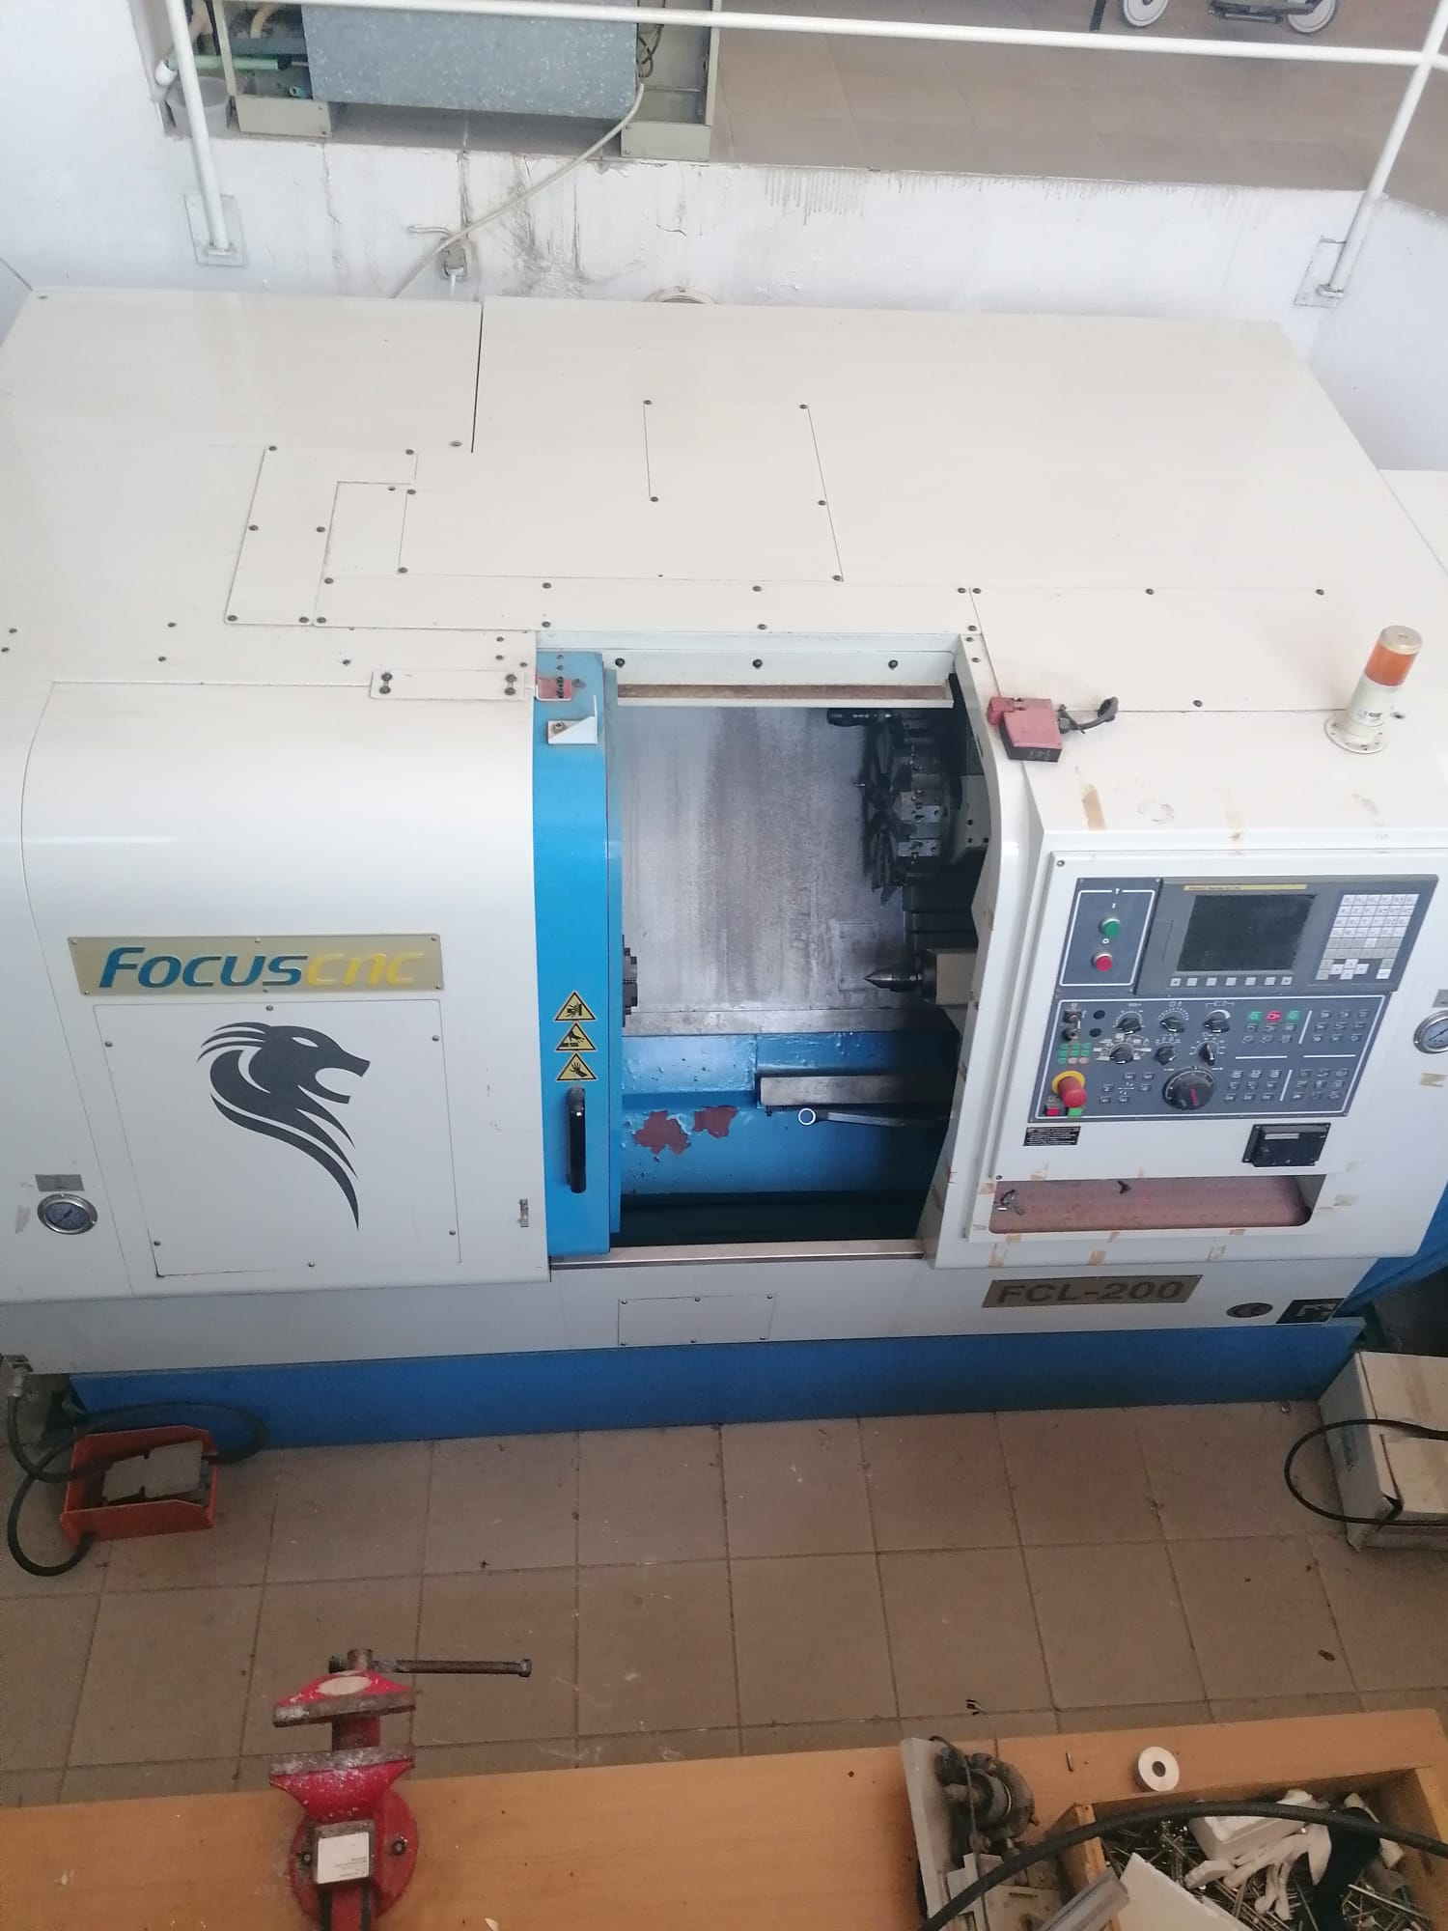
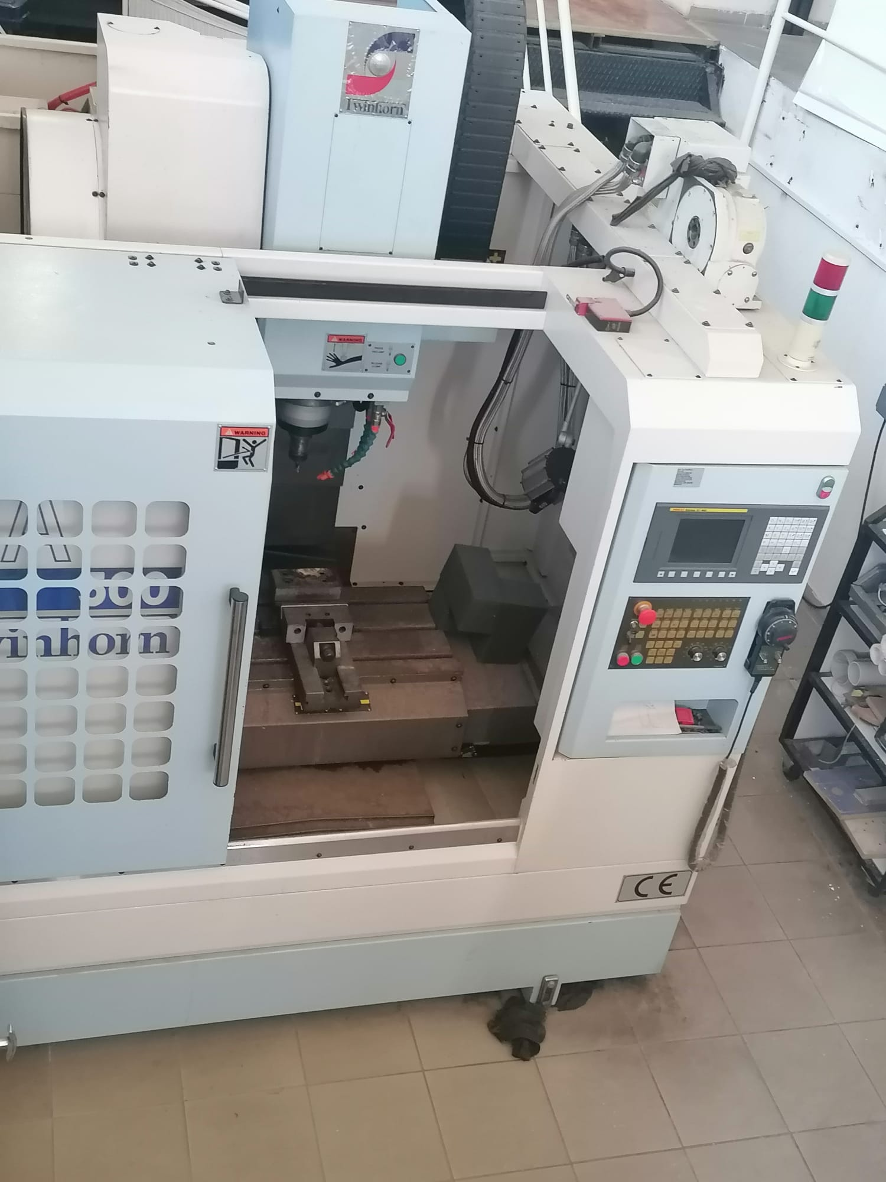

Slide 9
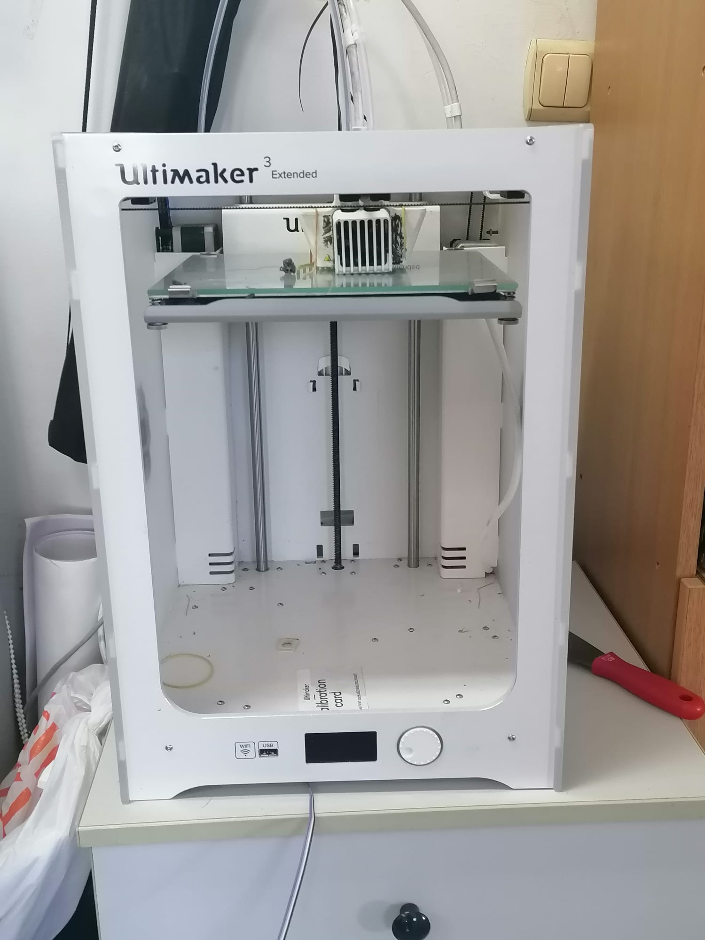
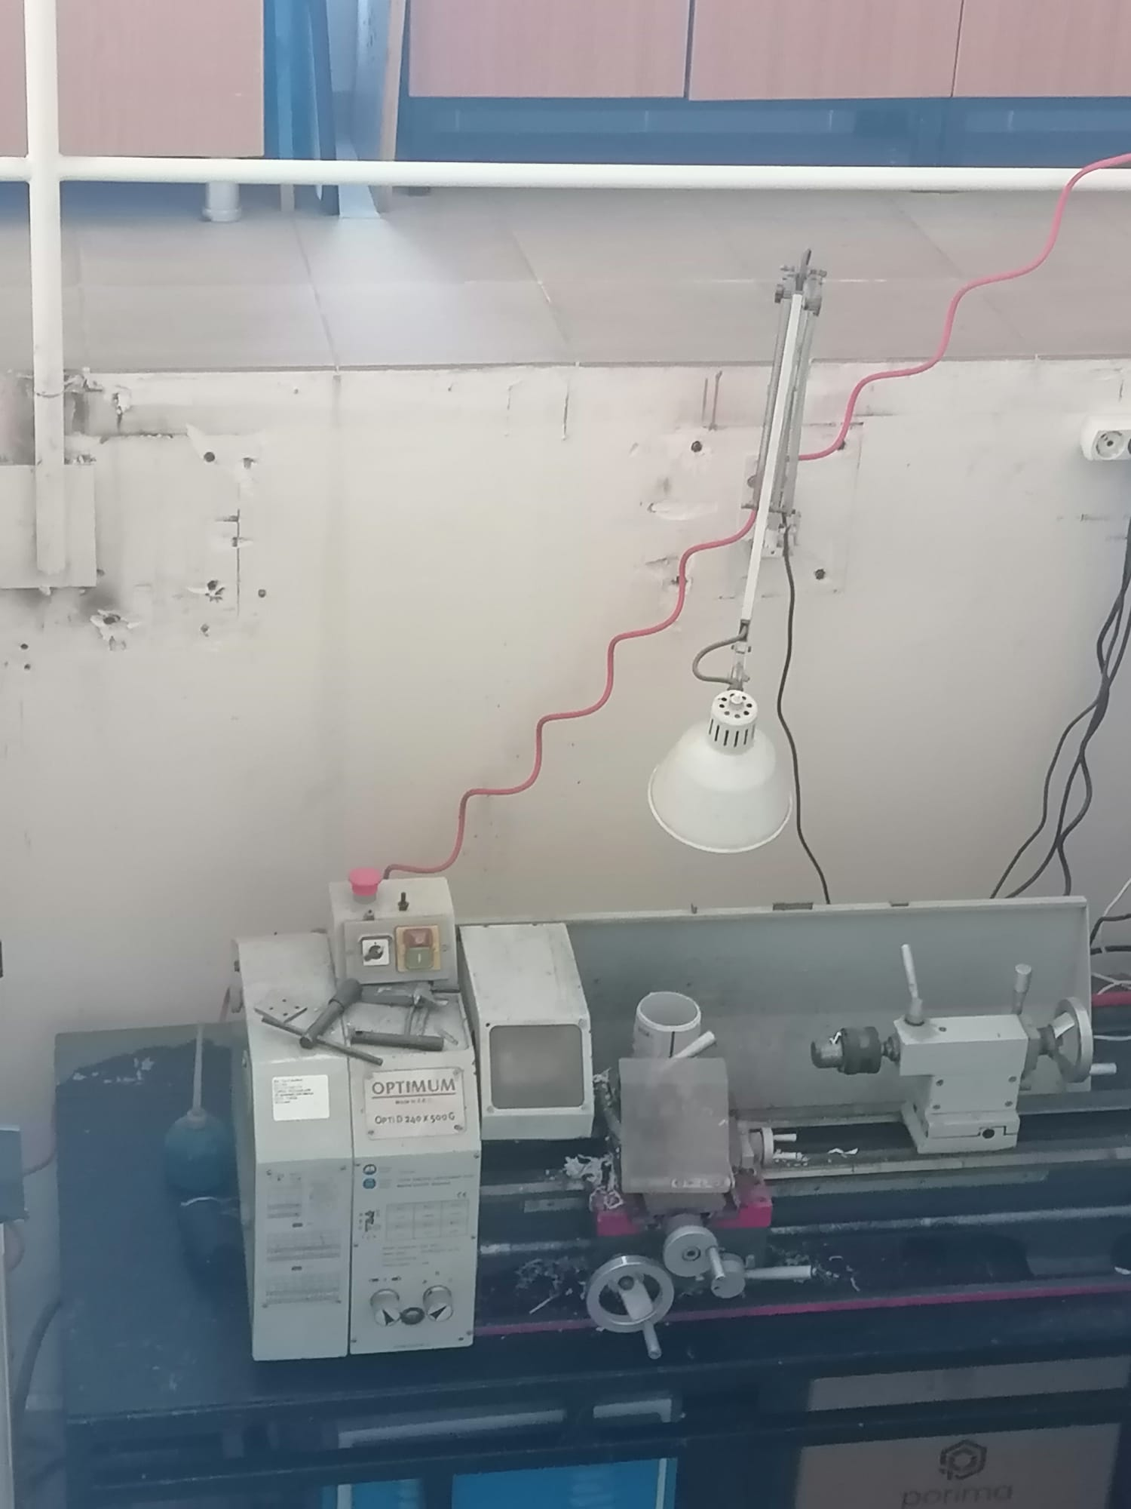

Slide 10
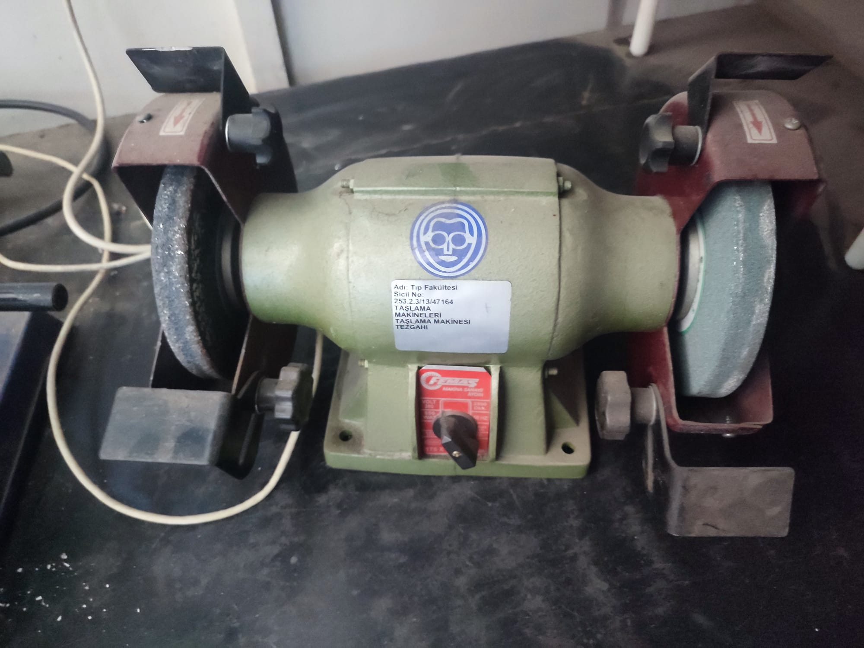
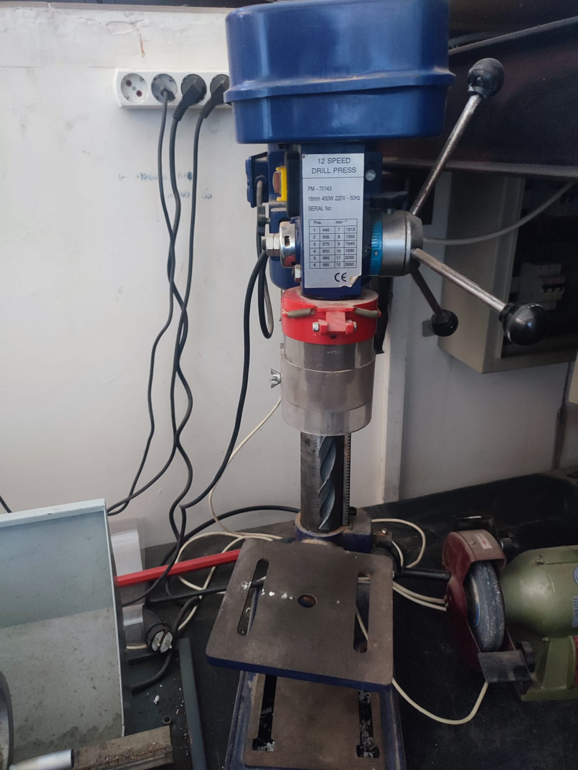

Slide 11
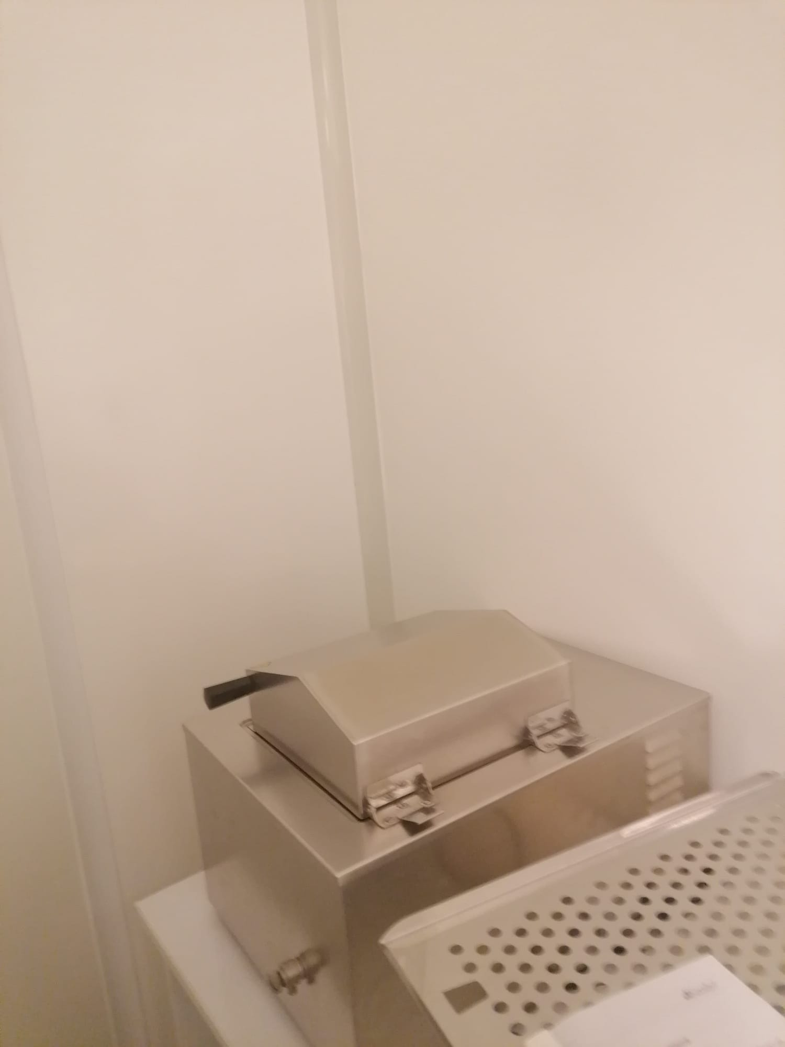
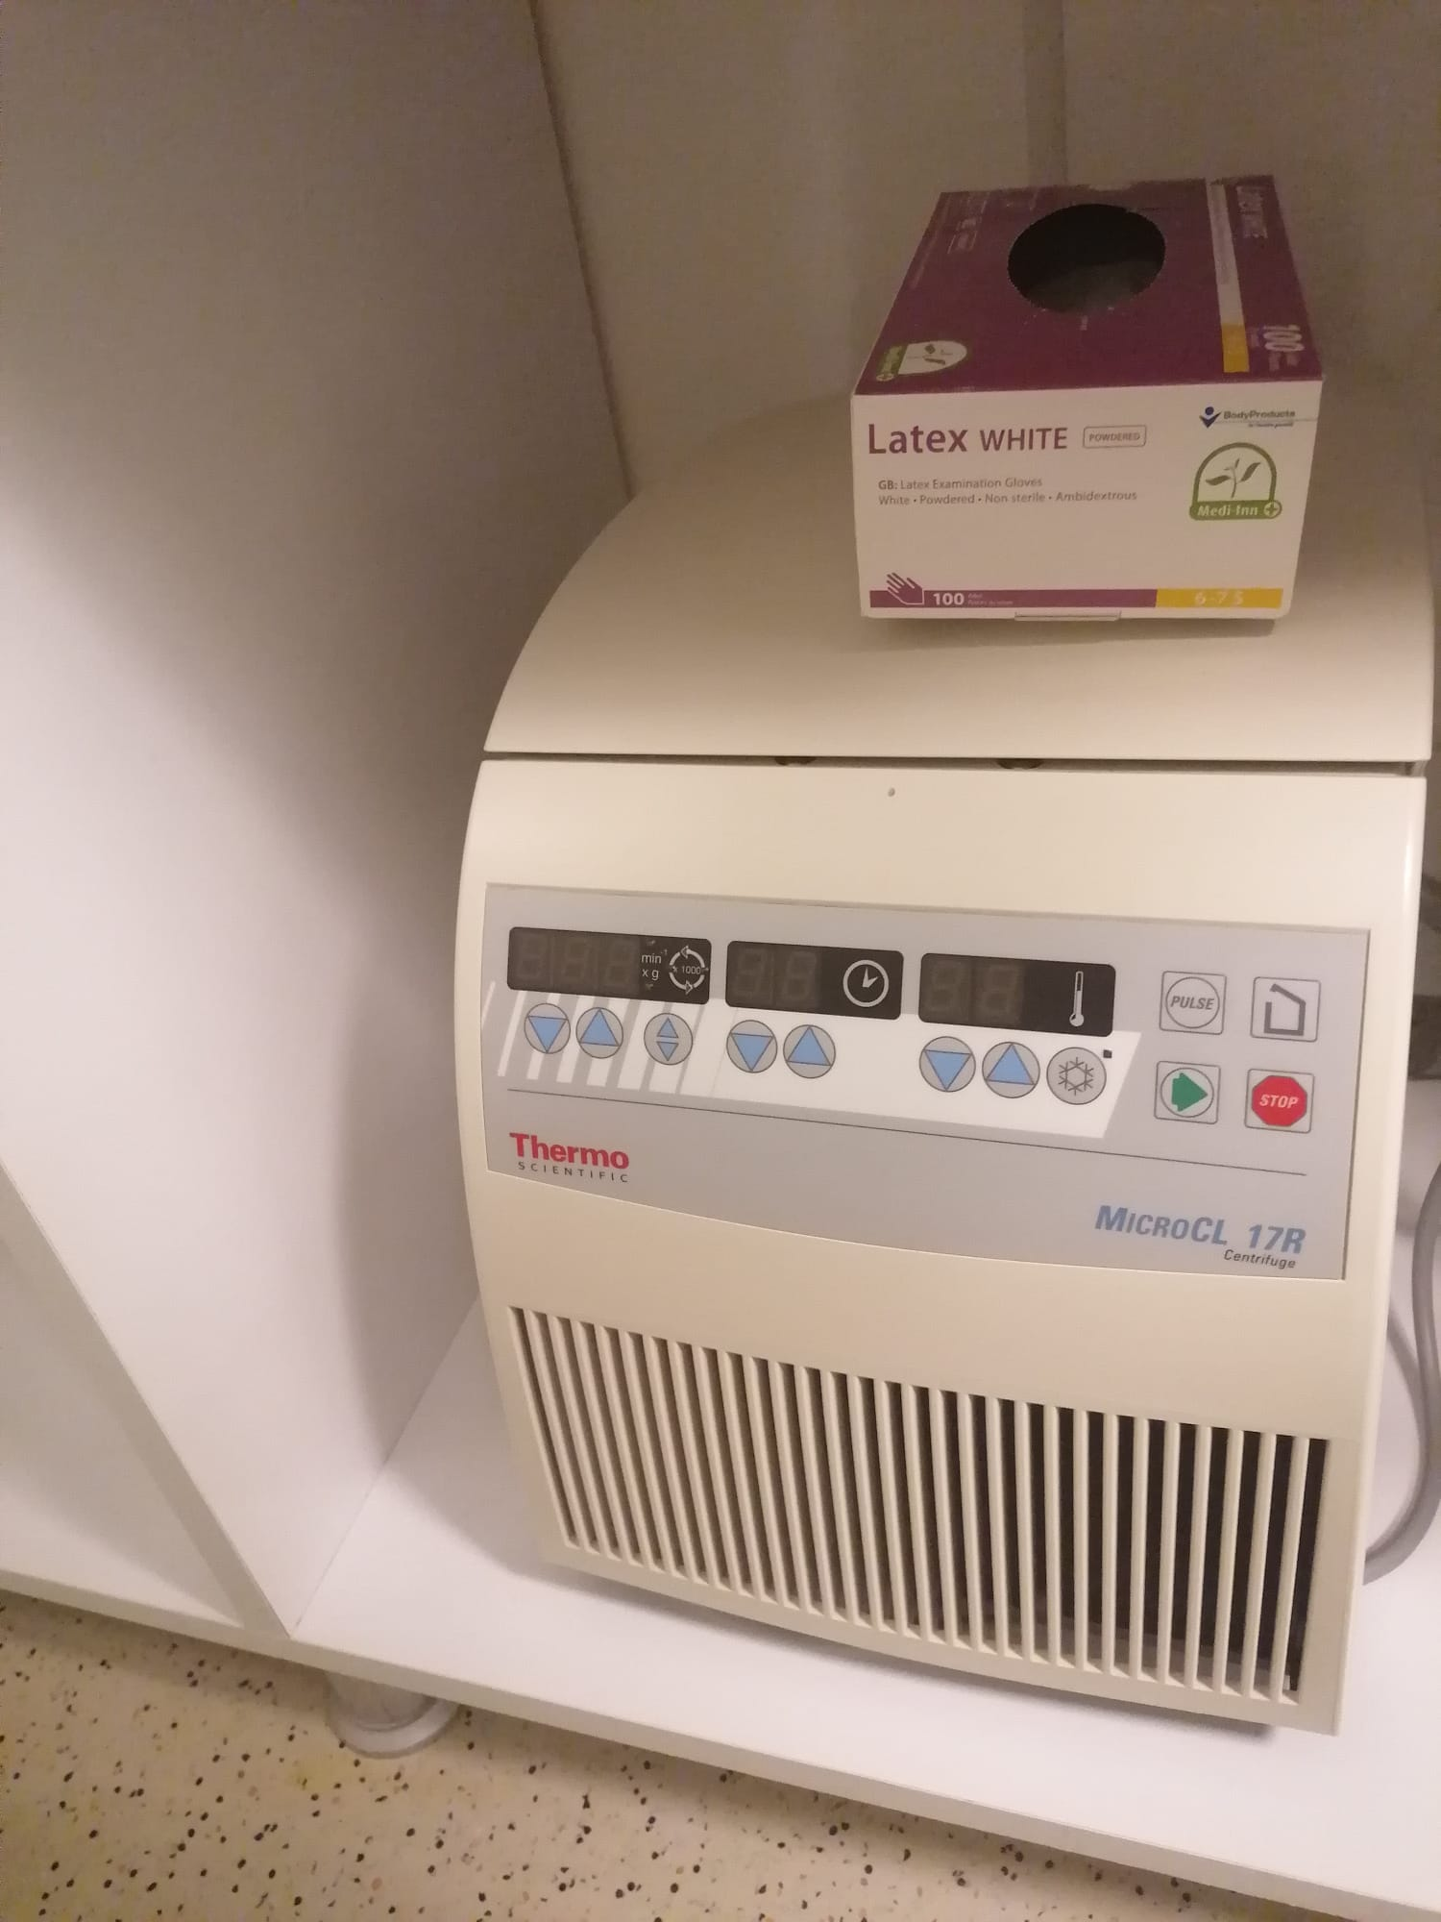

Slide 12
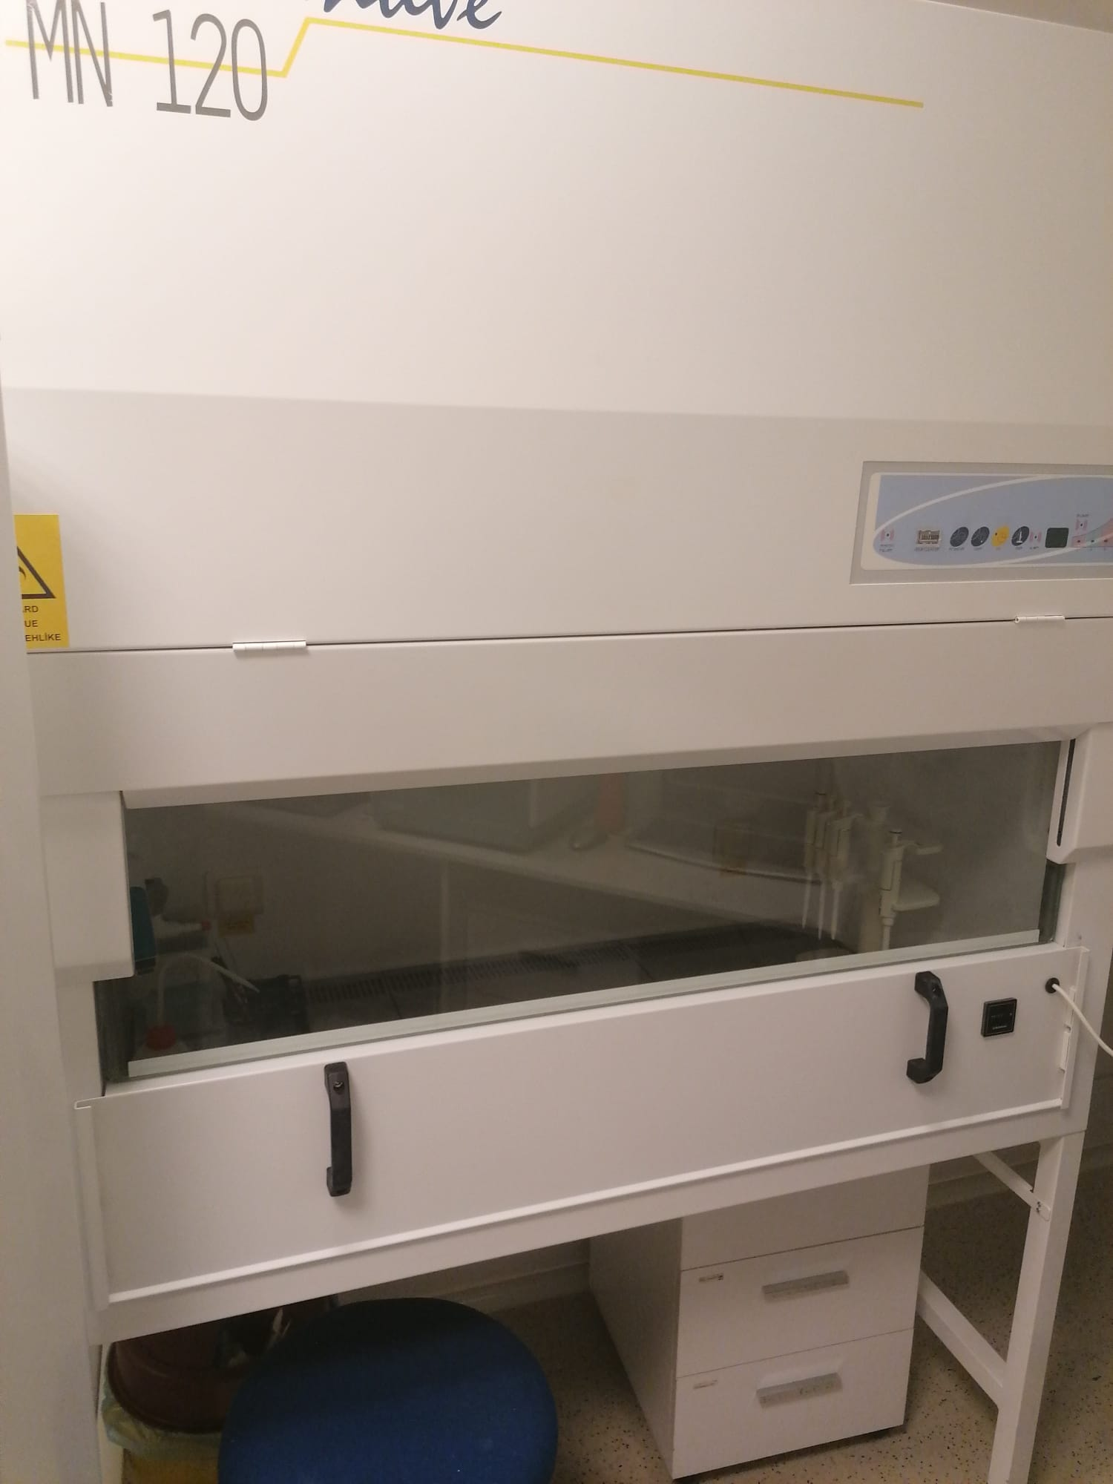
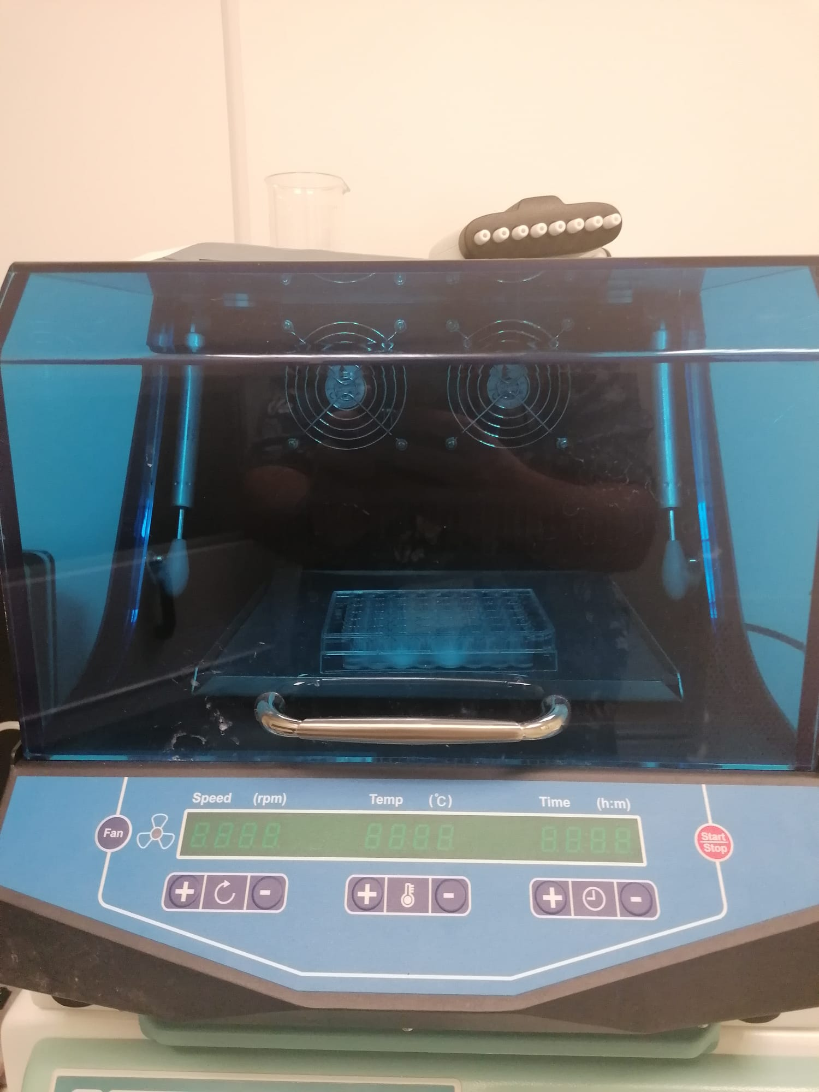

Slide 13
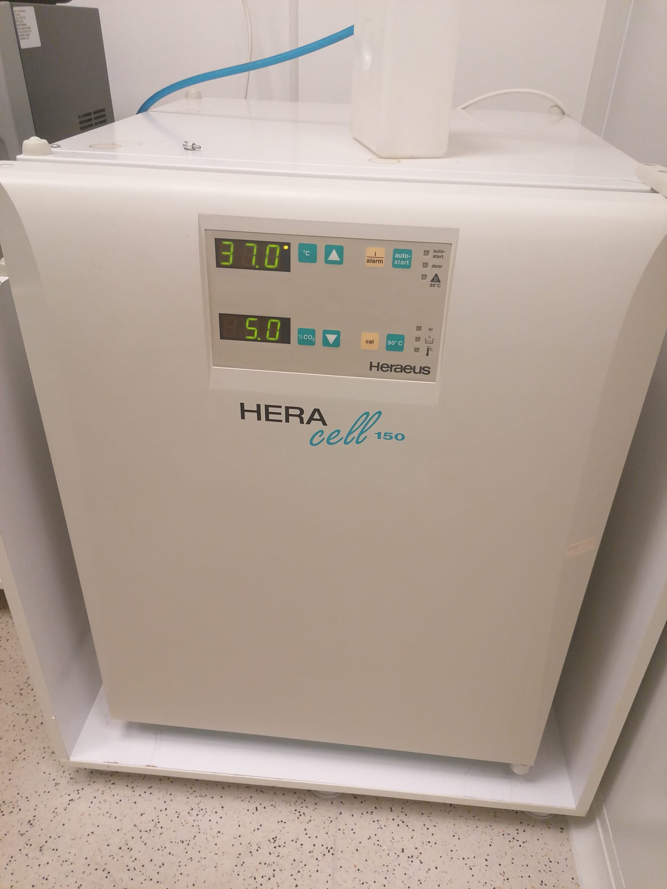
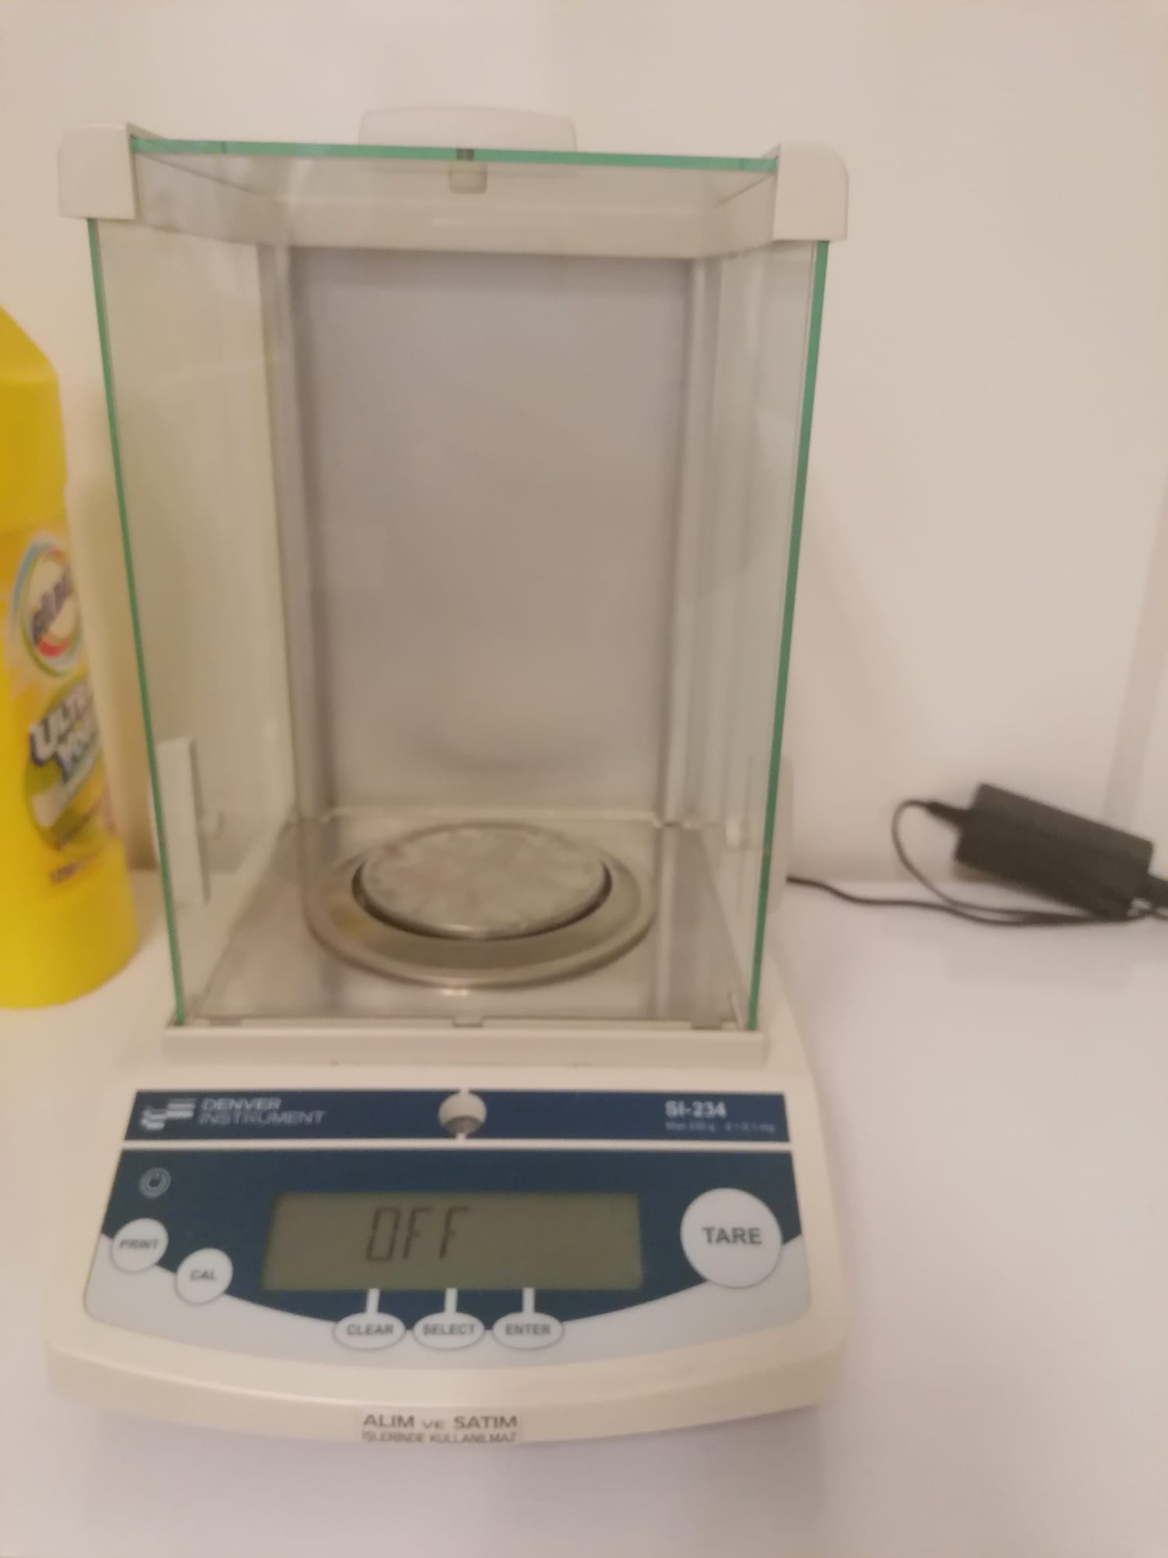

Slide 14
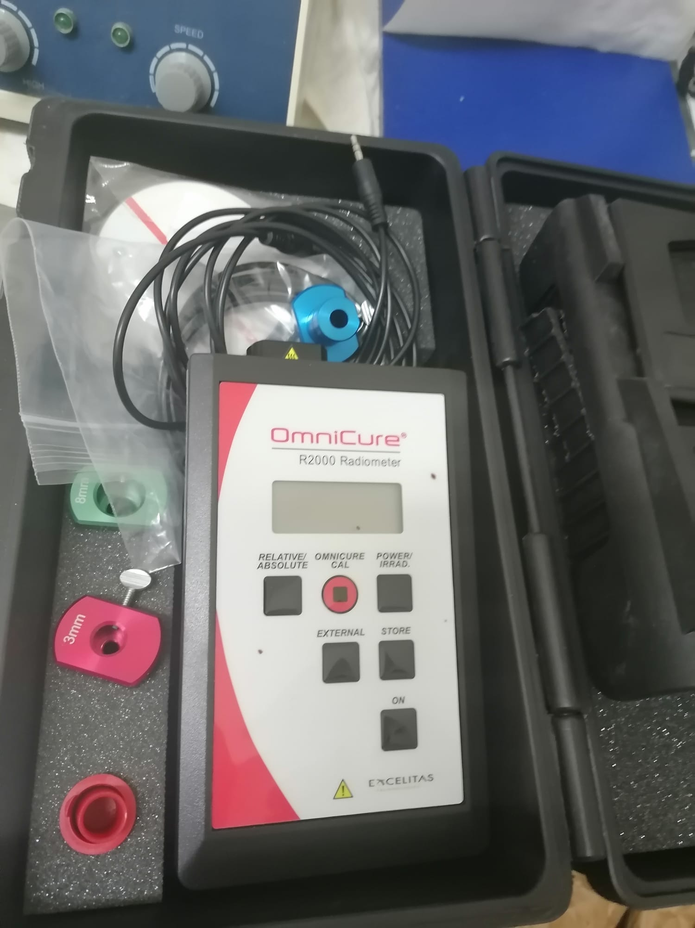
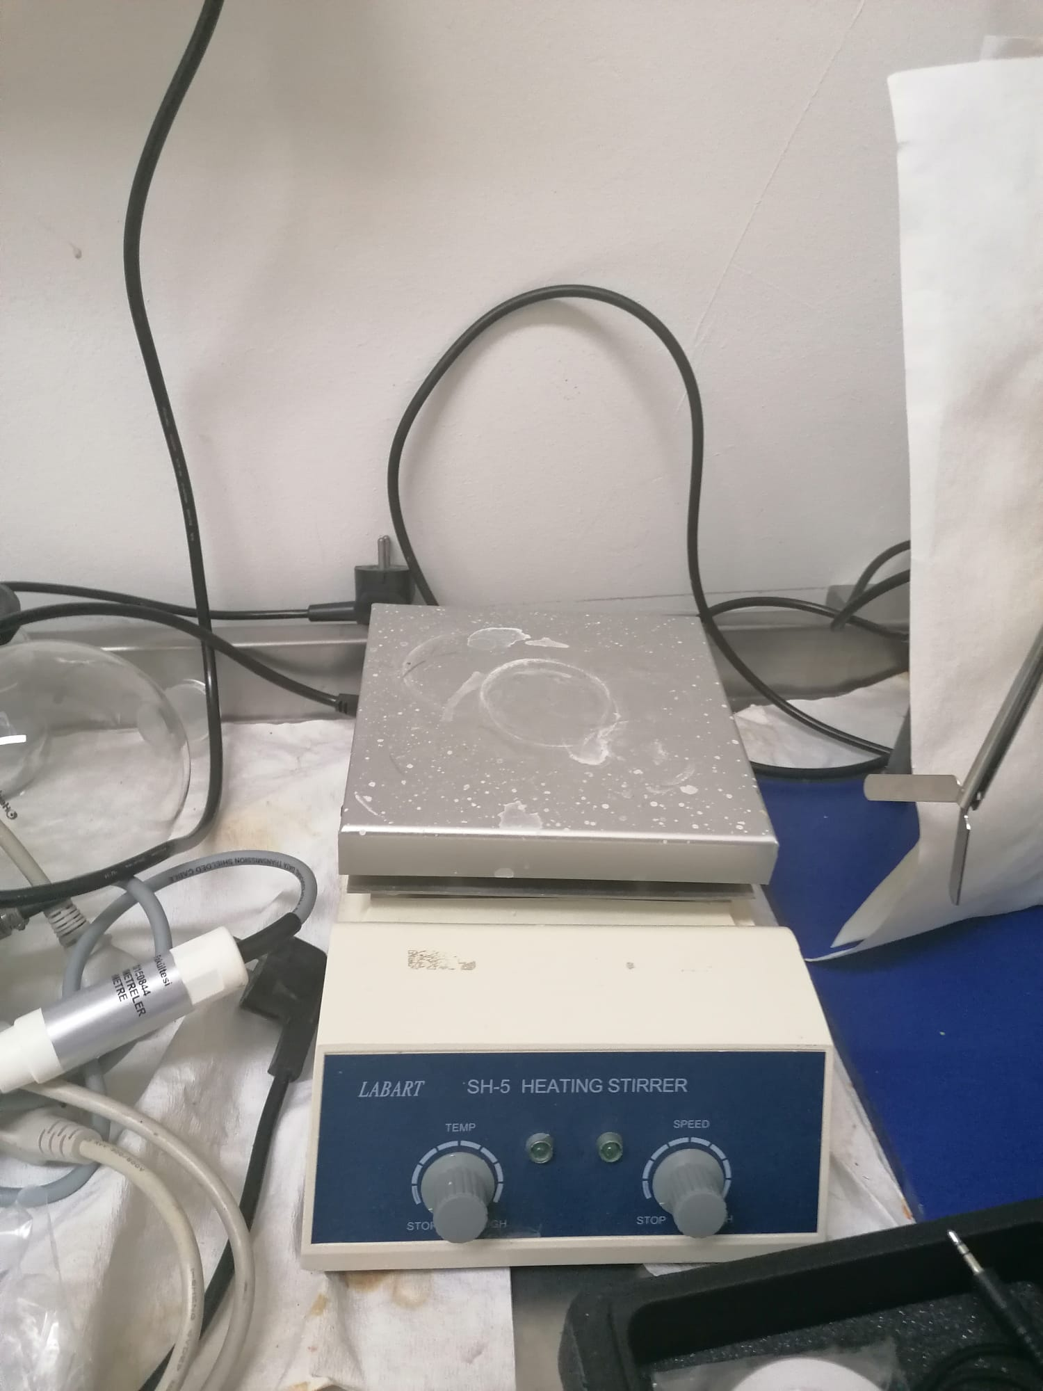

Slide 15
